Slide 1
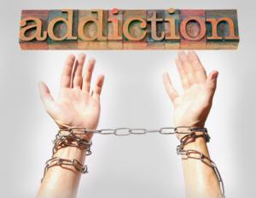
We are all Addicts

Slide 2
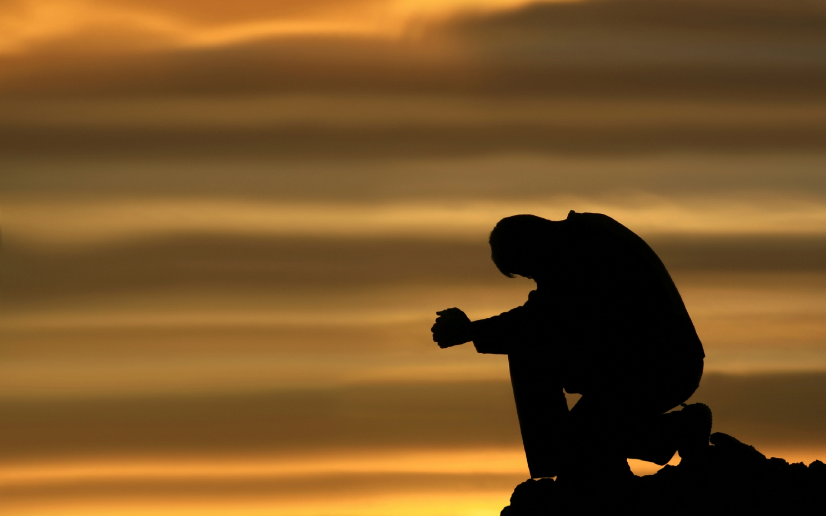
PRAYER

Slide 3
ANNOUNCMENTS

Slide 4

What does it mean to be addicted, & to have an addiction?

Slide 5
Addiction - Being enslaved to a habit, practice or substance such that withdrawal causes trauma.

Slide 6
Addict - to devote or surrender (oneself) to something habitually or obsessively

Slide 7
Is an addiction an Idol
(a false god)?
The temptations in your life are no different from what others experience. And God is faithful. He will not allow the temptation to be more than you can stand. When you are tempted, he will show you a way out so that you can endure.
1COR 10:13 NLT
Notes:
THE CLOAK OF DENIAL - Denial, Delusion, Blame - Complete isolation and slave to the sin.

Slide 8
You shall have no other gods before Me.
Dut 5:7 / Exo 20:3
Do we look at this differently now that we have talked about addictions as being gods?
Notes:
SLEEP, FOOD, WORK

Slide 9
How do we get addicted to something?
Jesus answered them, “Most assuredly, I say to you, whoever commits sin is a slave of sin. ³⁵ And a slave does not abide in the house forever, but a son abides forever.
³⁶ Therefore if the Son makes you free, you shall be free indeed.
Jn 8;34-36 NKJV

Slide 10
Addiction is a brain problem
Brain - over 100 billion neurons with each having upwards of 10,000 connections with other neurons. By weight it accounts for only 2% of body mass, but uses 20% of your energy. Makes 5 trillion decisions a second.
Notes:
Brian - (stars in the milky way)
Nurogenesis - Discovered in the 1990's
TRYING HARDER ONLY PUSHES YOU DEEPER INTO SHAME because you can't over come. You place your righteousness on your works & not the cross.

Slide 11
The brain
Lympic vs Pre-Frontal Cortex
Notes:
SLIDE 1 - What 2 parts are most responsible for decision making in the brain?
Lympic (reaction / gas peddle) vs Pre-Frontal Cortex (higher reason / breaks) not fully developed until 25
The more we think about the same thing, the stronger the connection or easier the path.

Slide 12
What is the result of addiction, what reward do we get from it?
Dopamine - A neurotransmitter that helps control the brain's reward & pleasure centers. Also helps regulate emotional responses, enabling us to identify rewards & take action towards them.
This is how we get good at sports or anything by rewarding us when we do good.
Notes:
Dopamine experiment - put probe into rat's brain & gave them a button to release dopamine right into the brain. 100% overdosed and died. Also present were food, water & rats of the opposite sex.

Slide 13
14 But each one is tempted when he is drawn away by his own desires and enticed. 15 Then, when desire has conceived, it gives birth to sin; and sin, when it is full-grown, brings forth death
JAMES 1:14-15 NKJV
Enticed / Drawn away (ἐξελκόμενος) only used here in the NT, is a metaphor for hunting & fishing, as animals are enticed from a safe place to a place with snares, or fishing bait.
Notes:
SLIDE 1 - How do you see this in your life, your thoughts, how you are distracted or attacked.
SLIDE 2 – Any thoughts?

Slide 14
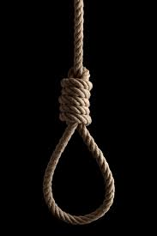
THE ROOT OF BONDAGE
THE MINDSET OF SHAME
Notes:
THE ROOT OF BONDAGE - (family dysfunction, personal trauma, addictive society) where Satan digs in and gets a hold of you
THE MINDSET OF SHAME (worthless, unlovable, alone, unworthy, high/reward followed by shame) - identity of the person after sin

Slide 15
How many gods do you have/ What are you addicted to? Reflect on this for a moment.
You can share if you choose, but no one will be asked.

Slide 16
Why can’t we stop? Are we just not dedicated enough?
And do not be conformed to this world, but be transformed by the renewing of your mind, that you may prove what is that good and acceptable and perfect will of God.
Rom 12:2 NKJV
Notes:
When we have an addiction our pre-frontal cortex is decoupled. Also causes less of a reward over time, why we move to synthetics (drugs). Examples - Very hungry eat strawberries (sweet & good). Same strawberry after a snickers bar - now sour or bitter (not God made).
When we give into temptation we know is wrong the fear center of the brain is activated amigdala, but the orbital cortex then fires & says don't do this causing apprehension, tension or pause to make a decision. If sin is committed chronically there is a molecular change on a genetic level in the orbital cortex releases the chemical Delta (Triangle) Fos B which causes a desensitization causing the alarm to stop sounding, hence what the bible calls a seared conscience.

Slide 17
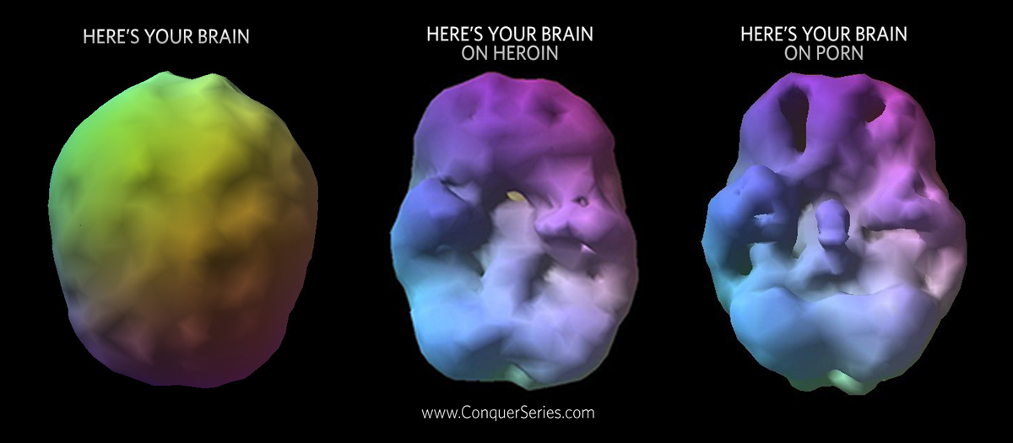

Slide 18
Are all addictions bad?

Slide 19
How can we recover from bad addictions & strengthen good ones?
We know that our old self was crucified with him in order that the body of sin might be brought to nothing, so that we would no longer be enslaved to sin. For one who has died has been set free from sin
ROM 6:6-7 ESV
Notes:
It has been found that most addictions are related to a trauma of some sort.

Slide 20
When you were slaves to sin, you were free from the obligation to do right. ²¹ And what was the result? You are now ashamed of the things you used to do, things that end in eternal doom.
ROM 6:20-21 NLT
casting down arguments and every high thing that exalts itself against the knowledge of God, bringing every thought into captivity to the obedience of Christ, ⁶ and being ready to punish all disobedience when your obedience is fulfilled.
2COR 10:5-6
Notes:
SLIDE 1 - The promise of sin is that it will satisfy, but it will only leave you worse off.
Even thoughts create & strengthen nuro pathways so to break the chain of sin we must control our thoughts.

Slide 21
Where does God want to be on your list of priorities?
Where IS He on your list of priorities?

Slide 22
What have you learned
From this lesson?
Was it helpful, will it change your thought process?

Slide 23
What’s next?
What comes after the realization that we have
not put God first?
That we have strayed from our first love.

Slide 24
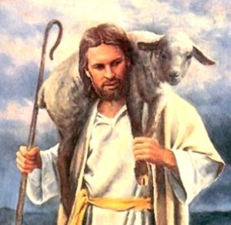
APRIL:
The Lamb on the Shepherds Shoulders

Slide 25
Questions & Discussion
Any questions, as time permits.

Slide 26
Prayer

Slide 27
Set Apirl date, location & food.

Slide 28
Go in peace

