Slide 1
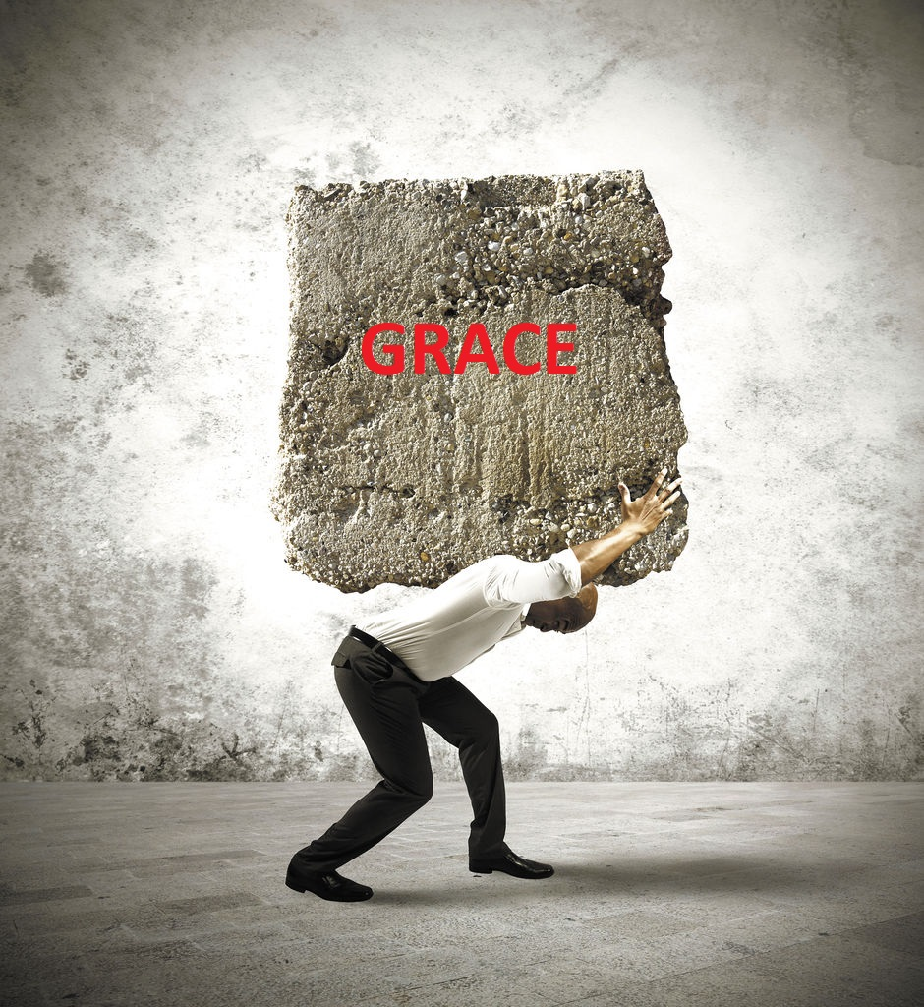
Crushed by Grace

Slide 2
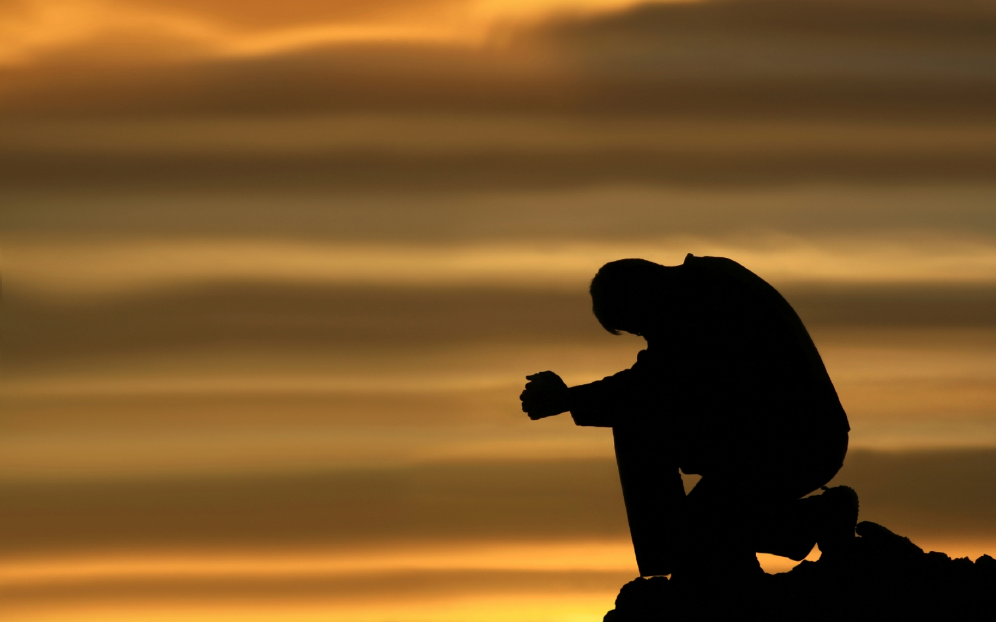
Prayer

Slide 3
SET OCT DATE

Slide 4

Announcements

Slide 5
The study of Grace
Graceology
Notes:
This study is just a scratch of the surface of the theology of Grace - the study of grace is called “Graceology”
Just like the study of future things is Eschatology
The study of Salvation “soteriology”
The study of God – Theology.
The study of the Person, nature, and role of Christ. – “Christology”

Slide 6
How do you define the word GRACE?

Slide 7
Webster Def:
a: unmerited divine assistance given humans for their regeneration or sanctification
b: a virtue coming from God
c: a state of sanctification enjoyed through divine grace

Slide 8
Why do we need GRACE?
We can't meet our own standard, let alone God's.

Slide 9
How do we experience God’s grace?

Slide 10
What is the difference between GRACE & MERCY?

Slide 11
Mercy - Withholds something you deserve.
Grace - Gives you something you don't deserve.
Notes:
Mercy – withholds punishment
Grace – Gives reward
The woman at the well - Jn 4:1-26 Grace
The adulterous woman to be stoned – Jn 8:1-11 Mercy

Slide 12
Things about grace
Quotes from “Grace is Greater” by Kyle Idleman
Paul uses the word grace more than 100 times in his letters as he helps the church understand grace. Jesus, on the other hand, never used the word grace. Instead He showed us what it looked like.
If grace is explained without being experienced, it really doesn't have much effect.
Grace can be dissected like a frog, but the thing dies in the process.
God's grace is compelling when explained but irresistible when experienced.

Slide 13
What about grace is offensive to people?

Slide 14
Quotes from Grace is Greater by Kyle Idelman
Until we recognize our need for grace, we won't care about receiving it.
As long as we think "I'm not that bad", grace will never seem that good.
If the biggest sinner you know isn't you, then you don't know yourself very well.

Slide 15
After all the questions & quotes, what does the bible say;

Slide 16
This is a faithful saying and worthy of all acceptance, that Christ Jesus came into the world to save sinners, of whom I am chief.
1Tim 1:15-16 NKJV
Notes:
This is Paul writing to Timothy

Slide 17
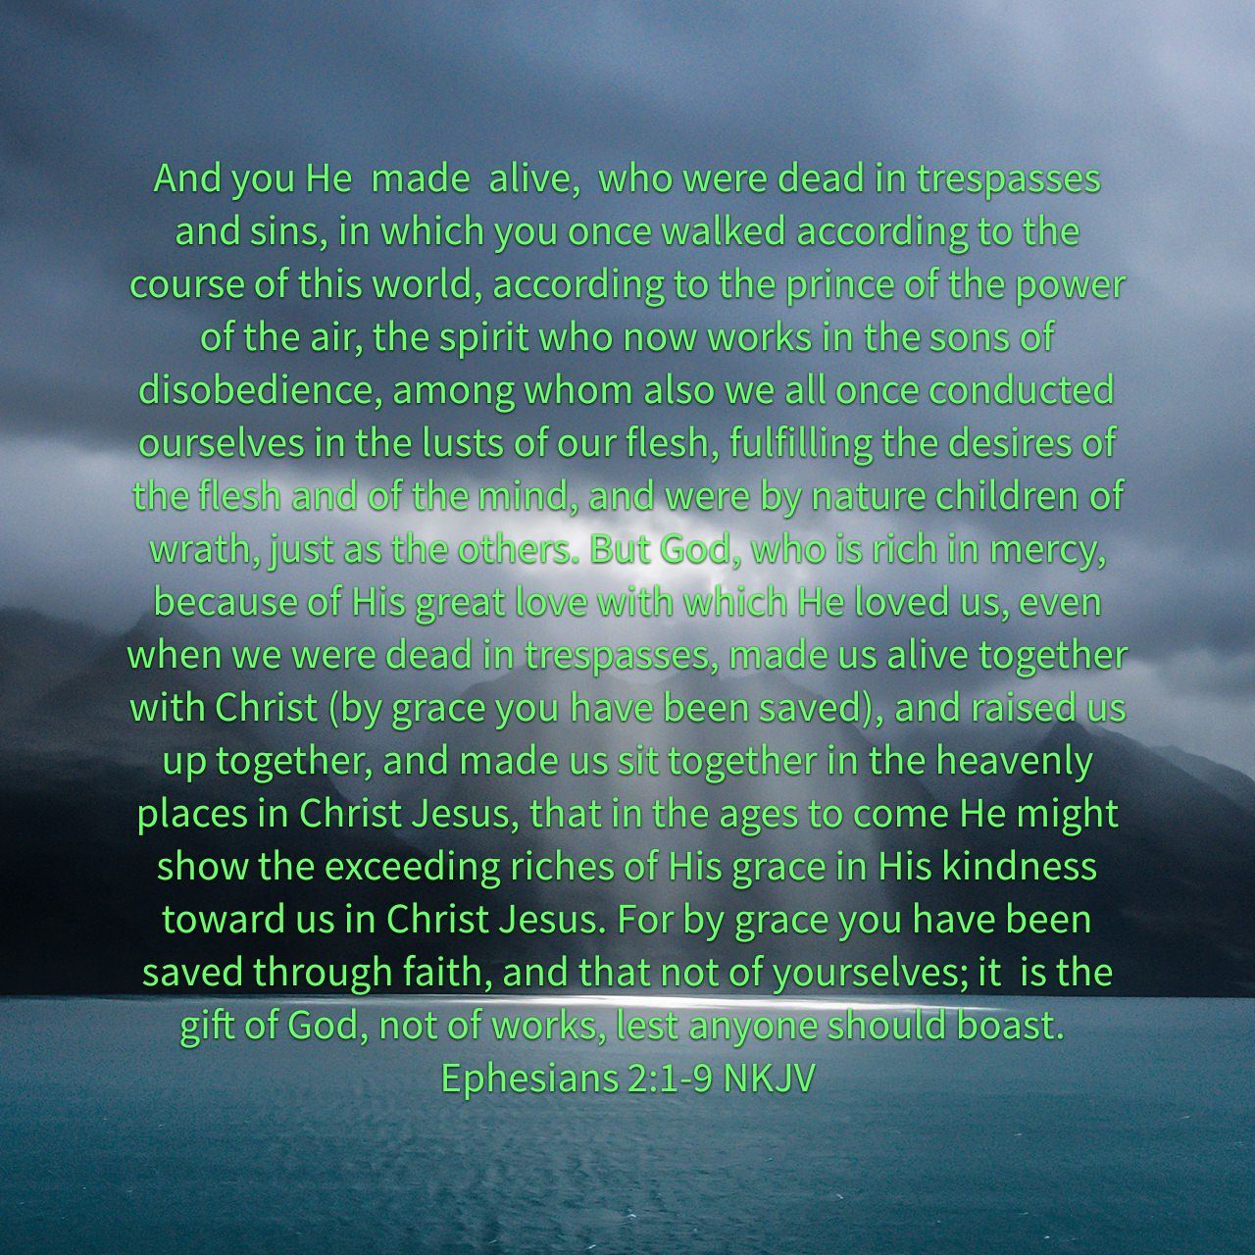

Slide 18
How do the “religious rules/the law” apply to us today?

Slide 19
For assuredly, I say to you, till heaven and earth pass away, one jot or one tittle will by no means pass from the law till all is fulfilled. Whoever therefore breaks one of the least of these commandments, and teaches men so, shall be called least in the kingdom of heaven; but whoever does and teaches them, he shall be called great in the kingdom of heaven. For I say to you, that unless your righteousness exceeds the righteousness of the scribes and Pharisees, you will by no means enter the kingdom of heaven.
Mat 5:18-20 NKJV

Slide 20
Or do you not know, brethren (for I speak to those who know the law), that the law has dominion over a man as long as he lives?
Rom 7:1 NKJV

Slide 21
Therefore, my brethren, you also have become dead to the law through the body of Christ, that you may be married to another—to Him who was raised from the dead, that we should bear fruit to God.
Rom 7:4 NKJV

Slide 22
What shall we say then? Is the law sin? Certainly not! On the contrary, I would not have known sin except through the law. For apart from the law sin was dead.
Rom 7:7-8 NKJV
Notes:
After – Intro the meeting of Paul & the Apostles about what the gentiles should do.

Slide 23
“And so my judgment is that we should not make it difficult for the Gentiles who are turning to God. Instead, we should write and tell them to abstain from eating food offered to idols, from sexual immorality, from eating the meat of strangled animals, and from consuming blood.
Acts 15:19-20 NLT
Notes:
After – Intro – So now does this mean anything outside of these 4 things will not cause us to step off the right path?

Slide 24
For what I am doing, I do not understand. For what I will to do, that I do not practice; but what I hate, that I do. If, then, I do what I will not to do, I agree with the law that it is good. But now, it is no longer I who do it, but sin that dwells in me. For I know that in me (that is, in my flesh) nothing good dwells; for to will is present with me, but how to perform what is good I do not find. For the good that I will to do, I do not do; but the evil I will not to do, that I practice. Now if I do what I will not to do, it is no longer I who do it, but sin that dwells in me.
Rom 7:15-20 NKJV
Notes:
Does this mean there will be no consequences and I can no longer sin? Yes & No, to answer that we have to look further.

Slide 25
Paul uses the word “will” several times. What is your definition of “will”?
Will – A conscious decision to give ones self over to an action, thought
or belief; knowing it will have consequences.

Slide 26
There is therefore now no condemnation to those who are in Christ Jesus, who do not walk according to the flesh, but according to the Spirit. For the law of the Spirit of life in Christ Jesus has made me free from the law of sin and death.
Rom 8:1-2 NKJV
Notes:
So then what’s the law for?

Slide 27
Galatians 3:24–25 (NLT)
24 Let me put it another way. The law was our guardian until Christ came; it protected us until we could be made right with God through faith. 25 And now that the way of faith has come, we no longer need the law as our guardian.

Slide 28
So what does all that mean?
Notes:
Love God above all things & Love your neighbor as yourself.

Slide 29
The penalty of SIN
Eternal vs Worldly
Notes:
Talk about how we no long have any penalty for sin, in eternity; but we can still suffer consequences from our choices here.

Slide 30
If we know that, then how do we allow the devil to convince us that we are not worthy/saved, that if people knew the real you, they wouldn’t like you let alone love you?

Slide 31
How is the satan/devil crushed by grace?

Slide 32
How are you crushed by grace?
And lest I should be exalted above measure by the abundance of the revelations, a thorn in the flesh was given to me, a messenger of Satan to buffet me, lest I be exalted above measure. 8 Concerning this thing I pleaded with the Lord three times that it might depart from me. 9 And He said to me, “My grace is sufficient for you, for My strength is made perfect in weakness.” Therefore most gladly I will rather boast in my infirmities, that the power of Christ may rest upon me. 10 Therefore I take pleasure in infirmities, in reproaches, in needs, in persecutions, in distresses, for Christ’s sake. For when I am weak, then I am strong.
2Cor 12:7-10NKJV
Notes:
These 3 verses have basically been ripped from the bibles of the mega feel good churches. The come to Jesus and life will be good theology, which is a lie. But these 3 verses don’t bode well for selling miracle spring water that will get your bank account filled & your house paid off.

Slide 33
31 And the Lord said, “Simon, Simon! Indeed, Satan has asked for you, that he may sift you as wheat. 32 But I have prayed for you, that your faith should not fail; and when you have returned to Me, strengthen your brethren.” NKJV (Lk 22:31–32).
Notes:
Talk about how Peter must have felt when he heard this from Jesus. It’s also right after this that Jesus tells Peter he will deny Him 3 times.

Slide 34
Instead of feeling despair about your failings, turn to God and give Him praise for his sacrifice and grace.

Slide 35
The true meaning of;
G
R
A
C
E
od’s
iches
t
hrist’s
xpense

Slide 36
Comments / Questions?

Slide 37
Prayer

Slide 38
Crushed by Grace

