Slide 1
The Lamb on the Shepherd's Shoulders

Slide 3
PRAYER

Slide 4
WHERE ARE WE IN OUR STUDY?
Notes:
Explain starting in Feb we looked at how we can fall into addiction & the slippery slope that leads to it. We looked at some of the pit falls around it & the tactics of the enemy. Hopefully we have begun to look inward to see where the enemy has setup strongholds in our lives & prayerfully sought God to show us where we are with Him. From here forward we will look at how to come back or get closer to Him. The questions are going to start to get more personal, the COVENANT will be important.

Slide 5
“What man of you, having a hundred sheep, if he loses one of them, does not leave the ninety-nine in the wilderness, and go after the one which is lost until he finds it? 5 And when he has found it, he lays it on his shoulders, rejoicing. 6 And when he comes home, he calls together his friends and neighbors, saying to them, ‘Rejoice with me, for I have found my sheep which was lost!’ 7 I say to you that likewise there will be more joy in heaven over one sinner who repents than over ninety-nine just persons who need no repentance. LK 15:4-7 NKJV

Slide 6
How did we get lost?
Notes:
We were born lost/dead, thanks to Adam & Eve in the garden.

Slide 7
What were we like before we knew Christ?
When you follow the desires of your sinful nature, the results are very clear: sexual immorality, impurity, lustful pleasures, idolatry, sorcery, hostility, quarreling, jealousy, outbursts of anger, selfish ambition, dissention, division, envy, drunkenness, wild parties, & other sins like these as I have before, that anyone living that sort of life will not inherit the Kingdom of God. Gal 5:19-21
Notes:
Sorcery = pharmakaia (drugs)
Wild Parties = orgies

Slide 8
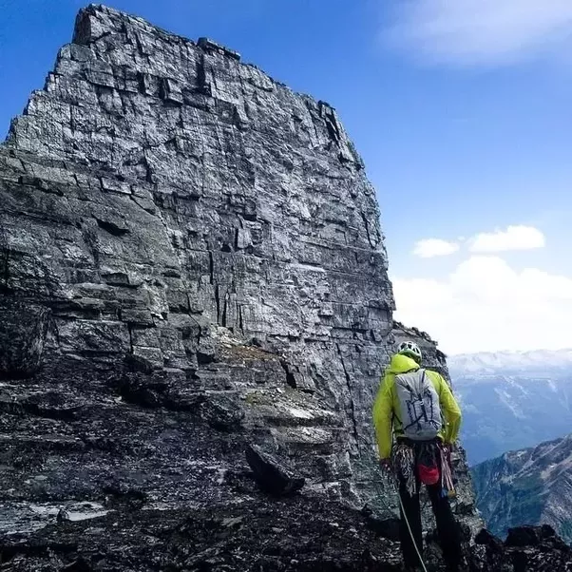
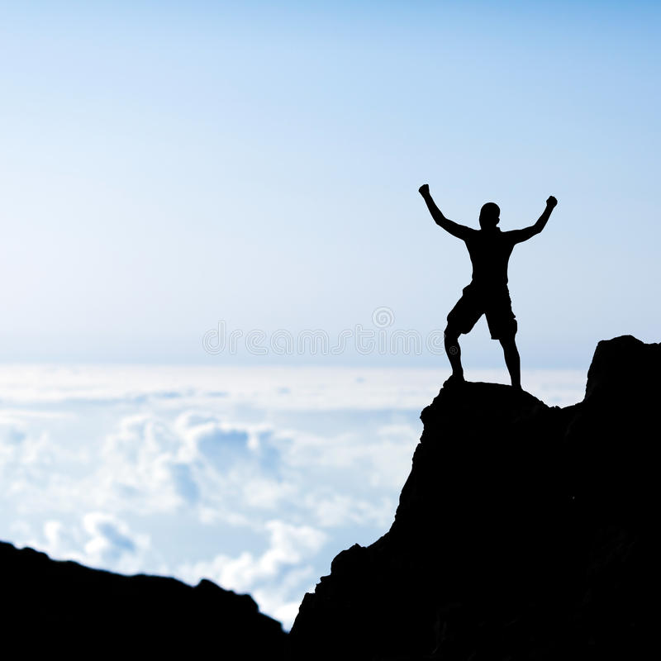
WHERE ARE YOU ON THE MOUNTAIN WITH GOD?
Notes:
WHAT’S HOLDING YOU BACK?

Slide 9
WHEN ARE WE LOST?
WHEN WE KNOW WE ARE LOST, OR BEFORE?
Notes:
Hiking, on a drive anywhere, do we ever realize we are lost right when we become lost? Wouldn't that be conceivable to happen with sin in our life also? So we continue to wander away from Jesus thinking He's right behind us or "not that far away".

Slide 11
DOES THAT CHANGE YOUR VIEW ON REPENTANCE vs SHAME?
ANY INSIGHTS?

Slide 12
yet now I am happy, not because you were made sorry, but because your sorrow led you to repentance. For you became sorrowful as God intended and so were not harmed in any way by us. Godly sorrow brings repentance that leads to salvation and leaves no regret, but worldly sorrow brings death.
2 CO 7:9-10 NIV

Slide 13
HAVE YOU EVER FALLEN AWAY FROM GOD?
IF SO, & YOU’VE FOUND YOUR WAY BACK,
WHAT BROUGHT YOU BACK?
Notes:
Jan 03 - Nov 2014. Brief explanation
*** I start with this question.

Slide 14
WE KNOW THE BASIS OF THE STORY OF THE LOST LAMB, BUT WHY IS JESUS CARRYING THE LAMB?
Notes:
Backslidding - The lamb has run away from the shepherd.
The rock & staff - broken leg – THE ROD OF CORRECTION
Carried - Pee & poop was worth it! Weeks with that on them but WORTH IT!
Got to correct it or it may lead others astray.

Slide 15
My sheep hear My voice, and I know them, and they follow Me.
JN 10:27 NKJV
Notes:
Does anything here stand out to you?
My sheep hear My voice – those who aren’t His sheep don’t hear His voice or know Him. Thus they won’t follow Him.

Slide 16
And when he brings out his own sheep, he goes before them; and the sheep follow him, for they know his voice. 5 Yet they will by no means follow a stranger, but will flee from him, for they do not know the voice of strangers
JN 10:4-5 NKJV

Slide 17
“I am the good shepherd. The good shepherd gives His life for the sheep. But a hireling, he who is not the shepherd, one who does not own the sheep, sees the wolf coming and leaves the sheep and flees; and the wolf catches the sheep and scatters them. The hireling flees because he is a hireling and does not care about the sheep. I am the good shepherd; and I know My sheep, and am known by My own. As the Father knows Me, even so I know the Father; and I lay down My life for the sheep. And other sheep I have which are not of this fold; them also I must bring, and they will hear My voice; and there will be one flock and one shepherd.
JN 10:11-16 NKJV
Notes:
Speaking to Jews - the other fold are the Gentiles.
I lay down My life for the sheep = knowingly with premeditation. Not a reaction, but a conscious descision.

Slide 18
I turned away from God, but then I was sorry. I kicked myself for my stupidity! I was thoroughly ashamed of all I did in my younger days.’
JER 31:19 NLT

Slide 19
IF YOU COULD GO BACK & CHANGE THE TOP 5 REGRETFUL SINS YOU COMMITTED, WOULD YOU?
Notes:
No, I see how they were used to bring me to my knees & guide me. In my weakness came my love for others & then my strength.

Slide 20
My son, do not despise the chastening of the LORD, Nor detest His correction; 12 For whom the LORD loves He corrects, Just as a father the son in whom he delights.
PROV 3:11-12 NKJV

Slide 21
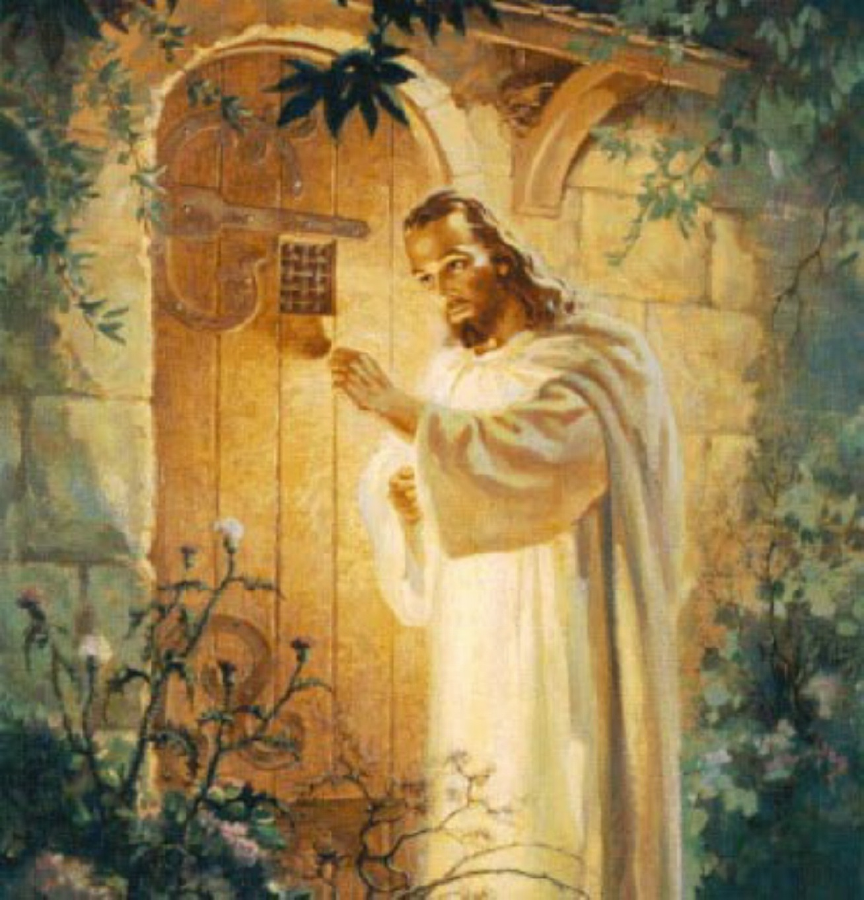
I correct and discipline everyone I love. So be diligent and turn from your indifference. 20 “Look! I stand at the door and knock. If you hear my voice and open the door, I will come in, and we will share a meal together as friends
REV 3:19-20 NLT

Slide 22
THIS WAS WRITTEN TO THE CHURCH, HOW COULD A CHURCH NOT LET JESUS IN?

Slide 23
Nevertheless I have this against you, that you have left your first love _{(agape)}. 5 Remember therefore from where you have fallen; repent and do the first works, or else I will come to you quickly and remove your lampstand from its place—unless you repent.
REV 2:4-5
Notes:
1st love = Agape

Slide 24
ARE YOU RUNNING FROM JESUS, BEING CORRECTED BY HIM, BEING CARRIED BY HIM OR STANDING NEXT TO HIM?

Slide 25
if My people who are called by My name will humble themselves, and pray and seek My face, and turn from their wicked ways, then I will hear from heaven, and will forgive their sin and heal their land
2CH 7:17 NKJV

Slide 26
THE PRODIGAL SON
LK 15:11-32
Notes:
Prodigal Son, Father & God. In this story there is not 1 word of repentance, because the entire story is about repentance.
The word Prodigal is extremely wide, deep & broad. Prodigal living = unlimited extravagance. He got a lot of money.
Son says to dad pretend your dead & give me what I would get & the father does.
Making the world serve him, the he serves the world.
Returns home, the very place he wanted nothing to do with, he is now happy just to be there. The same yet new – repentance
He asks to be “Like” a servant. He wants to be a son – keep that relationship even tho it is defiled it is unchangable, but is willing to do anything just be at his father’s home.
His father sees him “a great way off” & though as yet far, far away, our Father recognizes His own child in us, and bounds to meet us—not saying, Let him come to Me and sue for pardon first, but Himself taking the first step.
He gives him a new robe – restoring his position, a ring & shoes – slaves were barefoot.
His brother is in the field – a sign of the world; & he is doing his father’s business.
that I might make merry with my friends—It was no entertainment for the gratification of the prodigal: it was a father’s expression of the joy he felt at his recovery.
LK 15:10 - Likewise, I say to you, there is joy in the presence of the angels of God over one sinner who repents.”

Slide 27
WHAT ARE YOU WASTING YOUR RICHES/TALENTS ON?

Slide 28
5 This is what the Sovereign LORD, the Holy One of Israel, says: “In repentance and rest is your salvation, in quietness and trust is your strength, but you would have none of it.
ISA 30:15 NIV

Slide 29
WHAT IS YOUR MAIN TAKE AWAY FROM THIS & WHAT WILL YOU DO IN THE NEXT MONTH TO GROW CLOSER TO GOD?

Slide 30
NEXT MONTH: CRUSHED BY GRACE

