Slide 1
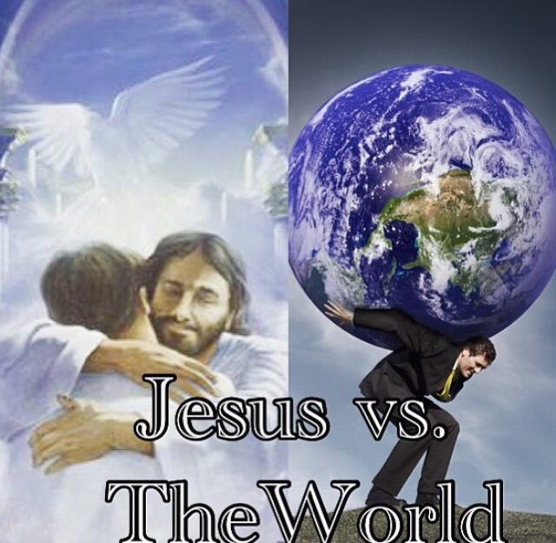
Cultural Christianity

Slide 2
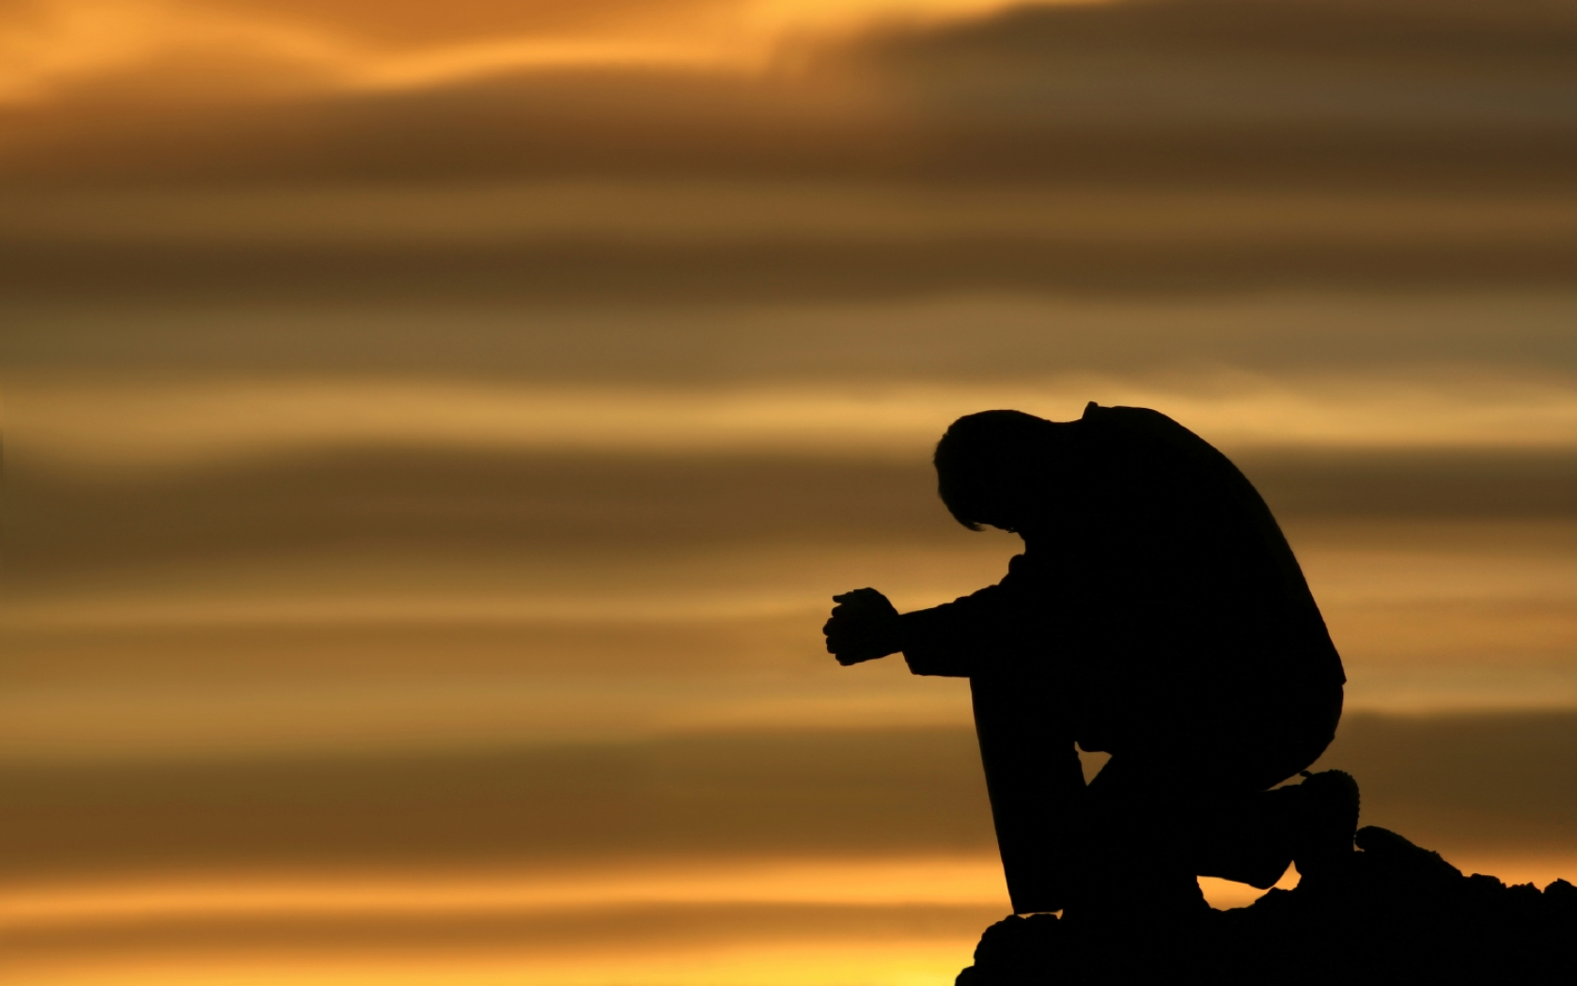
Prayer

Slide 3

Set Nov. Date

Slide 4
Announcements
This lesson will require interaction, discussion & is intended to challenge all of us.

Slide 5
Cultural Christianity – What are we talking about?
Saying your a Christian, while still acting like the world.
Still fitting in with non-Christians, like before you believed

Slide 6
If Christianity were outlawed tomorrow & you were put on trial, would there be enough evidence to convict you?
If you have a possible defense, if the evidence isn’t insurmountable, why not?

Slide 7
Do you act different when you are around different groups of people?
ie do you talk one way at church & another way at work/school/home?

Slide 8
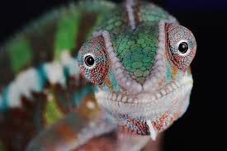
Do you act different when you are around different groups of people?
ie do you talk one way at church & another way at work/school/home?
Are you a Christian, or a social chameleon?

Slide 9
Do you care more about how others see you, or how Jesus sees you?

Slide 10
In what ways do we still "flirt" with the world?

Slide 11
How does the bible tell us to act?

Slide 12
Don’t copy the behavior and customs of this world, but let God transform you into a new person by changing the way you think. Then you will learn to know God’s will for you, which is good and pleasing and perfect.
Rom 12:2 NLT

Slide 13
THE BIBLE
If you think you know better, you don’t.
If you think you’re fooling God, your not.
If you think God cares about/agrees with your “reason” for doing it your way, He doesn’t.
If you think, I will follow this part of the bible because I agree with it, or it’s easy; the question is who made you god?
You have just made yourself god, just as your father Satan.
Notes:
After #4 explain # 5

Slide 14
We saw this verse in our addiction study, and here it is again. It fits, because many of us are still "addicted" to this world.
Someone may tell you - "You are so heavenly minded that your no earthly good." But, the larger problem is that the church is so wordly minded that we are no spiritually good.

Slide 15
God’s readiness to give and forgive is now public. Salvation’s available for everyone! We’re being shown how to turn our backs on a godless, indulgent life, and how to take on a God-filled, God-honoring life. This new life is starting right now, and is whetting our appetites for the glorious day when our great God and Savior, Jesus Christ, appears. He offered himself as a sacrifice to free us from a dark, rebellious life into this good, pure life, making us a people he can be proud of, energetic in goodness.
Titus 2:11-13 The Message

Slide 16
It was by faith that Moses, when he grew up, refused to be called the son of Pharaoh’s daughter.
He chose to share the oppression of God’s people instead of enjoying the fleeting pleasures of sin. He thought it was better to suffer for the sake of Christ than to own the treasures of Egypt, for he was looking ahead to his great reward.
Heb 11:24-26 NLT

Slide 17
4 You adulterers! Don’t you realize that friendship with the world makes you an enemy of God? I say it again: If you want to be a friend of the world, you make yourself an enemy of God. 5 Do you think the Scriptures have no meaning? They say that God is passionate that the spirit he has placed within us should be faithful to him.
James 4:4-5

Slide 18
“No one can serve two masters; for either he will hate the one and love the other, or else he will be loyal to the one and despise the other.
Mat 6:24 NKJV

Slide 19
“If the world hates you, you know that it hated Me before it hated you.
If you were of the world, the world would love its own. Yet because you are not of the world, but I chose you out of the world, therefore the world hates you.
Jn 15:18-19 NKJV

Slide 20
11 Dear friends, I warn you as “temporary residents and foreigners” to keep away from worldly desires that wage war against your very souls. 12 Be careful to live properly among your unbelieving neighbors. Then even if they accuse you of doing wrong, they will see your honorable behavior, and they will give honor to God when he judges the world.
1Pet 2:11-12 NLT

Slide 21
5 So put to death the sinful, earthly things lurking within you. Have nothing to do with sexual immorality, impurity, lust, and evil desires. Don’t be greedy, for a greedy person is an idolater, worshiping the things of this world. 6 Because of these sins, the anger of God is coming. 7 You used to do these things when your life was still part of this world. 8 But now is the time to get rid of anger, rage, malicious behavior, slander, and dirty language.
Col 3:5-8

Slide 22
And whatever you do or say, do it as a representative of the Lord Jesus, giving thanks through him to God the Father.
Col 3:17 NLT

Slide 23
What does this all mean?
If we continue to act like the world am I saved, am I a Christian?
This doesn’t affect your eternal location! But;
Would you rather be a baby crawling around or an adult?
If all you ever get is the basics of the gospel, you can be saved
but God has SO much more planned for you!
But you will never experience that if you don’t grow up.
Isaiah 25:8a, Rev 21:4

Slide 24
CHALLENGE
What could you do THIS month to grow in Jesus & look less like a spiritual baby?

