Slide 1
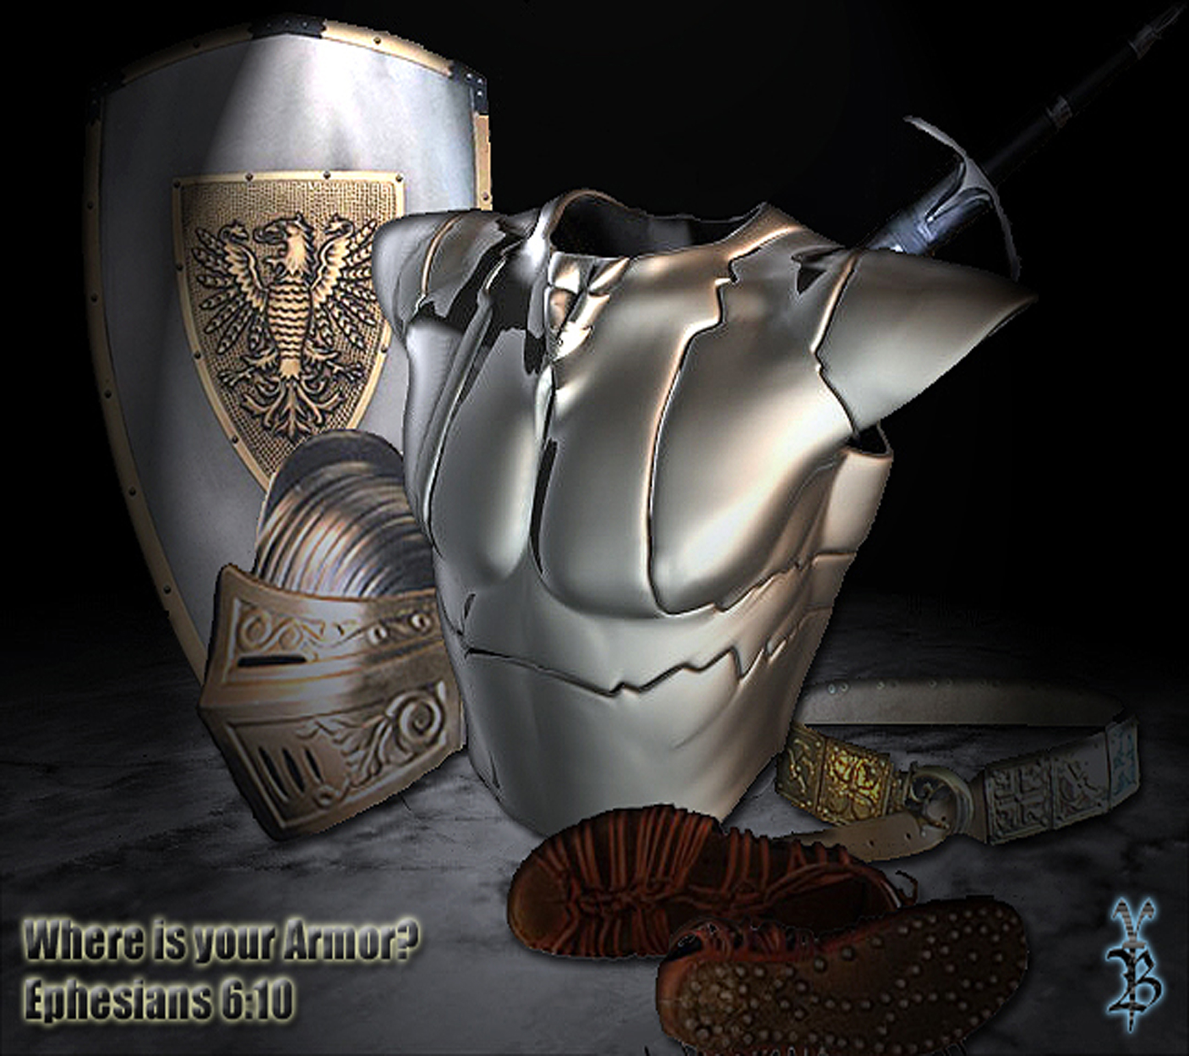

Slide 2
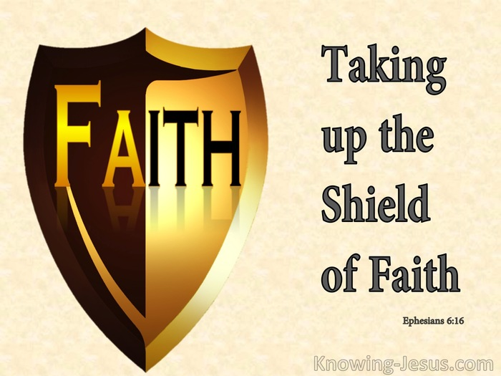

Slide 3
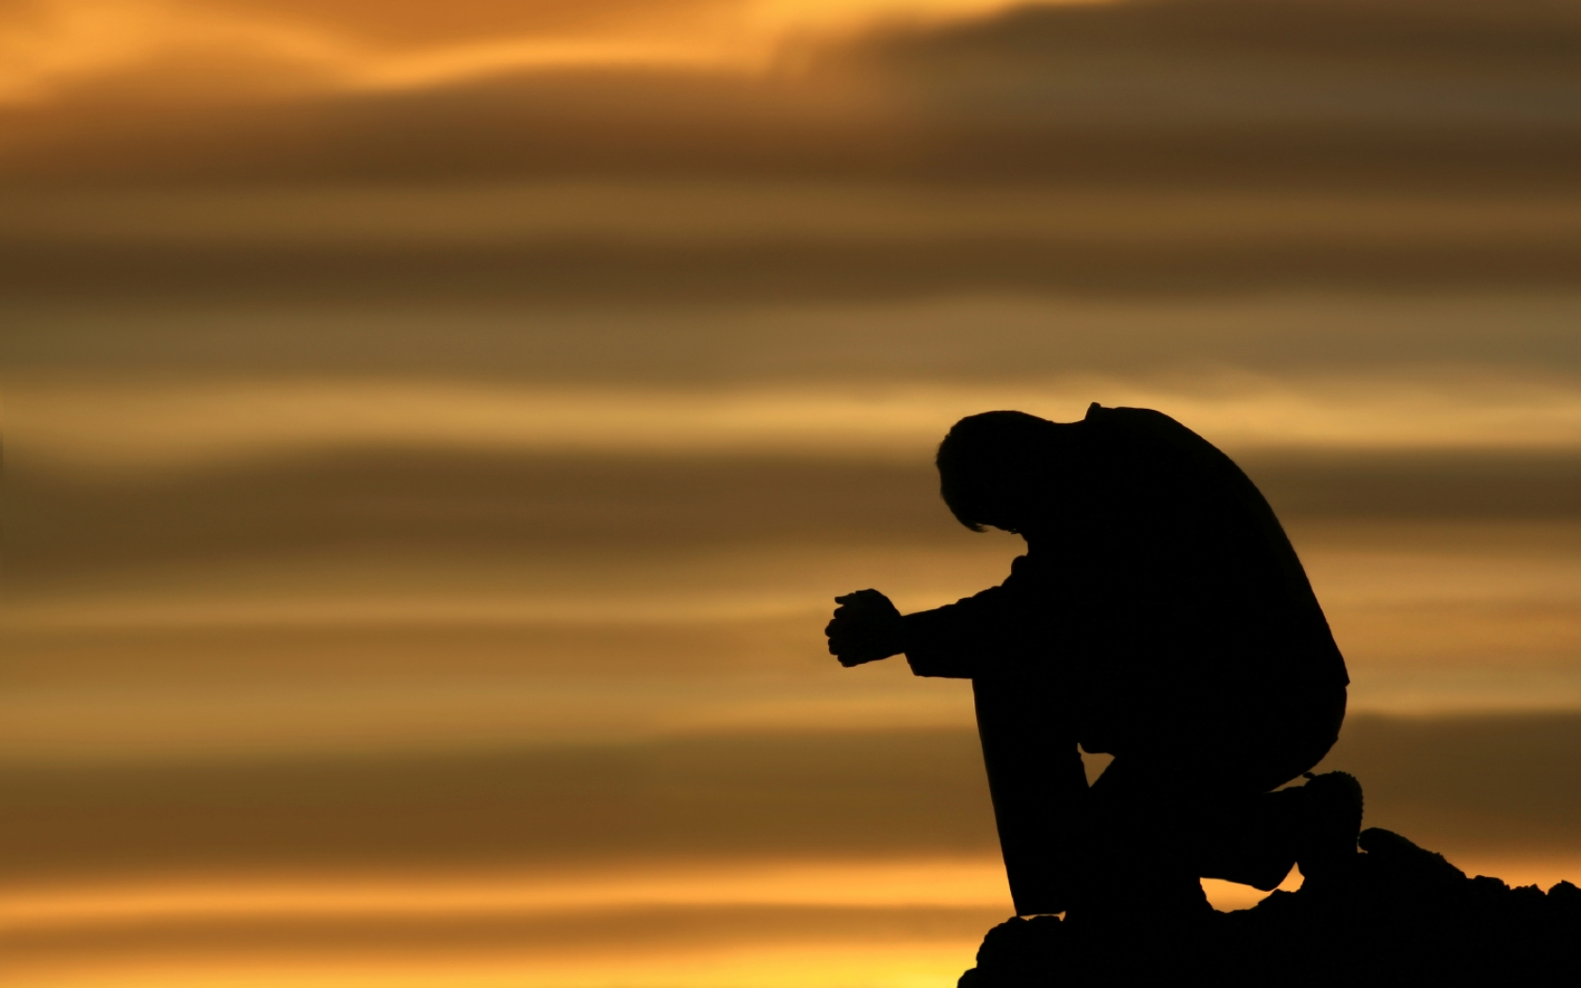
Prayer

Slide 4

Set Dec Date
Notes:
Huber’s cornbread
Jen – Roastx2
Mark & Kristen – Cheezy potatoes
Pell – Brarac cheese caserol & crackers
Addessi – Greek salad, bacalava
Chrichlow – green bean caserol
Melissa – potato dish
Tanners – spinich & arichoke dip

Slide 5
Announcements
Notes:
Explain Study overview

Slide 6
Put on the whole armor of God, that you may be able to stand against the wiles of the devil. For we do not wrestle against flesh and blood, but against principalities, against powers, against the rulers of the darkness of this age, against spiritual hosts of wickedness in the heavenly places. Therefore take up the whole armor of God, that you may be able to withstand in the evil day, and having done all, to stand. Stand therefore, having girded your waist with truth, having put on the breastplate of righteousness, and having shod your feet with the preparation of the gospel of peace; above all, taking the shield of faith with which you will be able to quench all the fiery darts of the wicked one. And take the helmet of salvation, and the sword of the Spirit, which is the word of God; praying always with all prayer and supplication in the Spirit, being watchful to this end with all perseverance and supplication for all the saints
Eph 6:11-18 NKJV

Slide 7
This study will focus on the
SHIELD OF FAITH

Slide 8
All the armor listed is from the Roman army. It’s the best armor available at this time.

Slide 9
How strong is your faith? How has it been tested?

Slide 10
What other words could you use besides “SHIELD”?
Notes:
Hidden in the original Greek is, I think, something Paul wants us to know about our SHIELD OF FAITH, but it doesn’t come across in the English.
What does the word Paul uses actually mean/convey?

Slide 11
Greek word used for shield - Thyreos (θυρεός)

Slide 12
This is the only place in the entire bible that this word is used.

Slide 13
The root word of Thyreos (θυρεός) is Thyra (θυρα)
Notes:
Explain root word chair = chair, recliner, rocking chair etc

Slide 14
What do you think this word means?
Take a guess, what could another word for “SHIELD” be?

Slide 15
Thyra (θυρα) =
DOOR or ENTRANCE

Slide 16
Any thoughts?

Slide 17
There are 4 different uses of this root word in the bible, & those 4 different words are used 46 times.

Slide 18
Thyra (θυρα) is used as;
1. Thyra (θυρα) = Door, Entrance or Gate
2. Thyrōros (θυρωρός) = doorkeeper
3. Thyris (θυρίς) = window
4. Thyreos (θυρεός) - Shield

Slide 19
Let’s look at Thyra (θυρα) = Door, Entrance or Gate.
This word is used 39 of the 46 times.
34 of those times it’s used as “DOOR” (1 other time it refers to access as a door)
It’s used 3 times as “ENTRANCE”
It’s used 2 times as “GATE”

Slide 20
Thyrōros (θυρωρός) = doorkeeper
This is used 4 times, & all 4 are in the gospels
1 time in Mark & 3 times in John.

Slide 21
Thyris (θυρίς) = window
Used 2 times

Slide 22
Thyreos (θυρεός) - Shield
Only used in Eph 6:16

Slide 23
Does that change how you view the SHIELD OF FAITH, if so how?
Our faith is the doorway/gateway/entrance through which all attacks must go first.

Slide 24
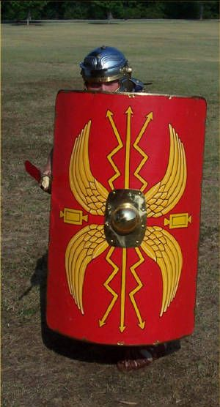
How this shield was made.
It was 4 feet long & 2.5 feet wide
It was made of 3 layers of bonded wood strips (plywood) covered by leather on the outside & a bronze rim covered the rounded edges for additional protection.
Notes:
You could hide most of a man behind it
The bonded wood strips were layered with the grain in different directions to add strength.

Slide 25
Each soldier would be given their shield & would be responsible for it, for life.
Notes:
Just as we are responsible for our faith.

Slide 26
They had to anoint their shield daily with oil, or the leather would become brittle and fail.
We have to anoint ourselves daily with the Word of God & prayer, or we will be come brittle & our faith will fail in battle.

Slide 27
Before a battle in which flaming arrows might be shot at them, the soldiers would wet (anoint) the leather covering with water to extinguish the arrows.
We have to know what the enemy will use against us, BEFORE, we walk into battle. Otherwise, we will not have prepared our armor for the fight.

Slide 28
Tactical uses;
The edges would be wedged against each other to form an interlocking wall. Much like the Spartans used (ie The 300)
For overhead threats they would use “The Tortoise” (Modern day “Shields in Support”) - They would close ranks with their shields, the first row holding their shields edge to edge in front, and the rows behind holding their shields above their heads.
Notes:
The curve of the shield would direct the attack to the sides of the shield in the case of a mass charge, where the swords of the 2nd line were waiting to meet them. The center was extremely strong!
In this formation they were practically invulnerable to arrows, rocks, and even spears.

Slide 29
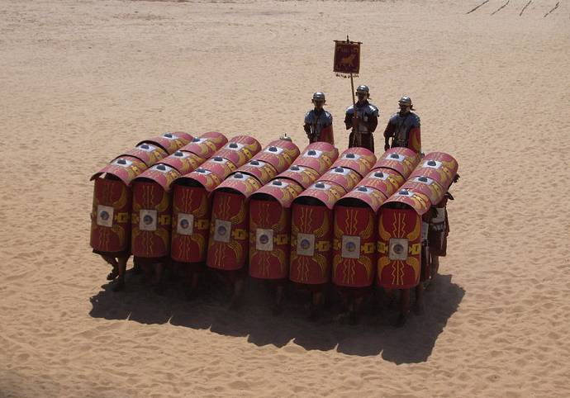
Notes:
When soldiers used their shields together each would bear only part of the weight of the attacking soldiers, the line behind them would assist with by leaning into the them and holding them in place while using their swords to attack in between the shields & when possible throwing spears at distance.
We must hold each other up when attacked and help bear the weight, we are one body, one army in a war with an enemy. We are stronger together then alone, if one shield breaks the next person must move up to take their place. Also while the first line of people are dealing with attacks in faith and with the Word, we, as their backup, are called to assist them from a greater distance with prayer (now referred to as the spear, but not by Paul).
But our war is much like the end of a war where the end is known 1 side is going to loose/surrender but the appointed time of that surrender is in the future. The fighting still continues & people still die, but our victory is assured.

Slide 30
Any thoughts?

Slide 31
Keep in mind where the shield was
above all, taking the shield of faith with which you will be able to quench all the fiery darts of the wicked one
^{Eph 6:16 NKJV}
What does “above all” imply to you?
so as to cover all that was put on before. Three hard outer layers are specified—the breastplate, girdle, and shoes; two defenses—the helmet and shield; and two offensive weapons—the sword and the spear (prayer).
Notes:
Not some, but all!

Slide 32
Above – epi (ἐπί)
Used 875 times in the bible.
Only 35 of the 875 times is it translated as “above”

Slide 33

= above

Slide 34
If 784 times it’s translated “on”, let’s look at it with the word “on”
on all, taking the shield of faith with which you will be able to quench all the fiery darts of the wicked one
^{Eph 6:16 NKJV}
Notes:
So on, as if it were something put on over or after something else.

Slide 35
  The shield’s strength seems to be linked to 3 things behind it, upon which it relies “on”.
TRUTH
ACCEPT YOU ARE A SINNER
RIGHTEOUSNESS
STANDARD OF SALVATION
THE GOSPEL
JESUS AS SAVIOR
FAITH
BELIEVE “ON” JESUS
SALVATION
CLEANSED & GIVEN THE HOLY SPIRIT
THE WORD
WE CAN NOW UNDERSTAND
PRAYER
Notes:
1-3 COME BEFORE FAITH
4 FAITH IS PUT ON THEM
5-8 CAN’T BE CHANGED SO THEY DON’T DEPEND ON YOUR FAITH, BUT THEY ARE USED TO MAKE YOUR FAITH MORE EFFECTIVE/SUBSTANTIAL.
TRUTH – YOU HAVE TO KNOW ARE A SINNER IN NEED OF A SAVIOR & THE TRUTH OF GOD.
RIGHT – THIS IS THE STANDARD TO ENTER HEAVEN, NO LESS.
GOSPEL – SHOWS HOW TO OBTAIN RIGHTEOUSNESS THROUGH THE SACRIFICE OF JESUS OUR SAVIOR.
FAITH – HERE IS WHERE WE TAKE THE HITS, WILL WE BELIEVE ALL THAT IS BEFORE, WHEN THAT STANDS (QUENCHES) THEN WE MOVE ON.
SALVATION – COMES THROUGH FAITH “ON” NOT IN JESUS (SATAN BELIEVES IN JESUS, JUST NOT ON JESUS) & WE ARE INDWELLED WITH THE HOLY SPIRIT.
WORD – THE HOLY SPIRIT NOW EXPLAINS & LEADS US THROUGH THE HIDDEN TRUTHS IN THE BIBLE (1 COR 2:10-12). [JUMPS TO SCRIPTURE THEN BACK TO PRAYER]

Slide 36
But God has revealed them to us through His Spirit. For the Spirit searches all things, yes, the deep things of God. For what man knows the things of a man except the spirit of the man which is in him? Even so no one knows the things of God except the Spirit of God. Now we have received, not the spirit of the world, but the Spirit who is from God, that we might know the things that have been freely given to us by God.
1Cor 2:10-12

Slide 37
  The shield’s strength seems to be linked to 3 things behind it, upon which it relies “on”.
TRUTH
ACCEPT YOU ARE A SINNER
RIGHTEOUSNESS
STANDARD OF SALVATION
THE GOSPEL
JESUS AS SAVIOR
FAITH
BELIEVE “ON” JESUS
SALVATION
CLEANSED & GIVEN THE HOLY SPIRIT
THE WORD
WE CAN NOW UNDERSTAND
PRAYER
WE ARE TO PRAY HIS WORD BACK
Notes:
1-3 COME BEFORE FAITH
4 FAITH IS PUT ON THEM
5-8 CAN’T BE CHANGED SO THEY DON’T DEPEND ON YOUR FAITH, BUT THEY ARE USED TO MAKE YOUR FAITH MORE EFFECTIVE/SUBSTANTIAL.
TRUTH – YOU HAVE TO KNOW ARE A SINNER IN NEED OF A SAVIOR & THE TRUTH OF GOD.
RIGHT – THIS IS THE STANDARD TO ENTER HEAVEN, NO LESS.
GOSPEL – SHOWS HOW TO OBTAIN RIGHTEOUSNESS THROUGH THE SACRIFICE OF JESUS OUR SAVIOR.
FAITH – HERE IS WHERE WE TAKE THE HITS, WILL WE BELIEVE ALL THAT IS BEFORE, WHEN THAT STANDS (QUENCHES) THEN WE MOVE ON.
SALVATION – COMES THROUGH FAITH “ON” NOT IN JESUS (SATAN BELIEVES IN JESUS, JUST NOT ON JESUS) & WE ARE INDWELLED WITH THE HOLY SPIRIT.
WORD – THE HOLY SPIRIT NOW EXPLAINS & LEADS US THROUGH THE HIDDEN TRUTHS IN THE BIBLE (1 COR 2:10-12).
PRAYER – WE ARE TO PRAY TO GOD THE PROMISES HE MADE IN HIS WORD, BECAUSE HE IS FAITHFUL.

Slide 38
How has this study changed your perception of the SHIELD OF FAITH from when we started?

Slide 39
How are you going to “ANOINT” your shield of faith in this coming month?

Slide 40
Which piece of armor would you like to cover next?
Truth, Righteousness, The Gospel, Salvation
The Word?

Slide 41
Prayer

