Slide 1
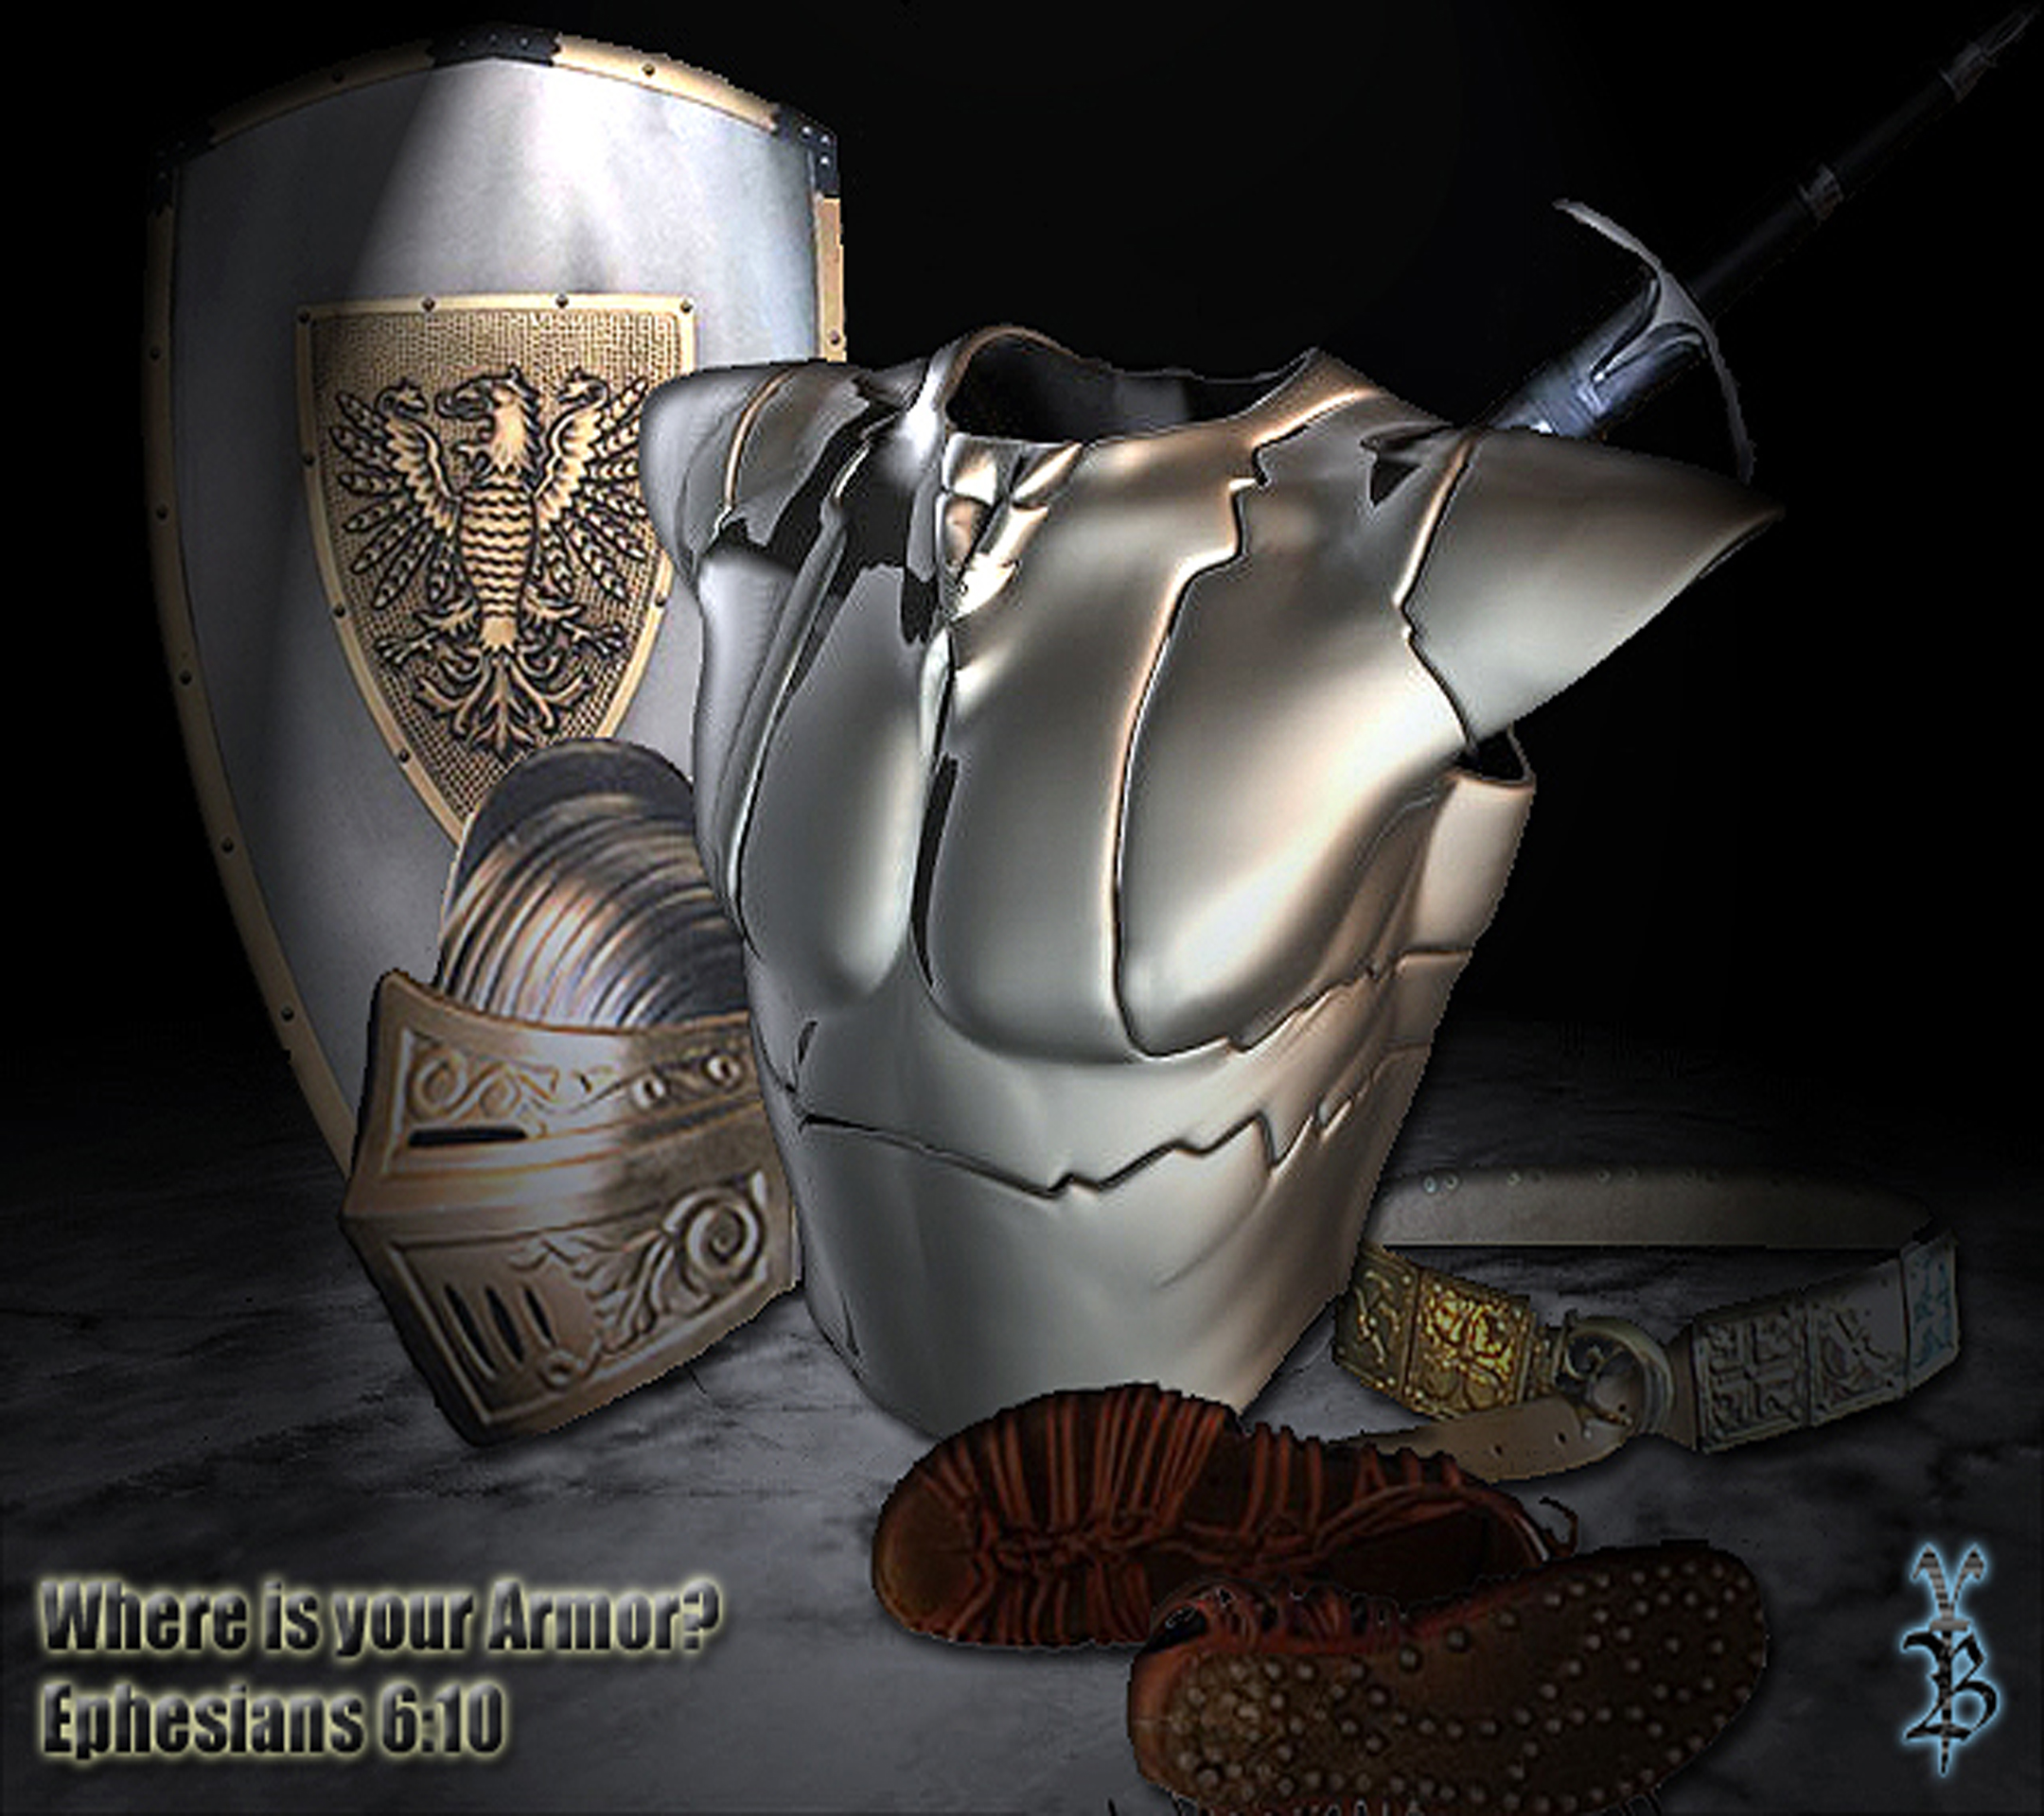
The Armor of God - Helmet of Salvation

Slide 2
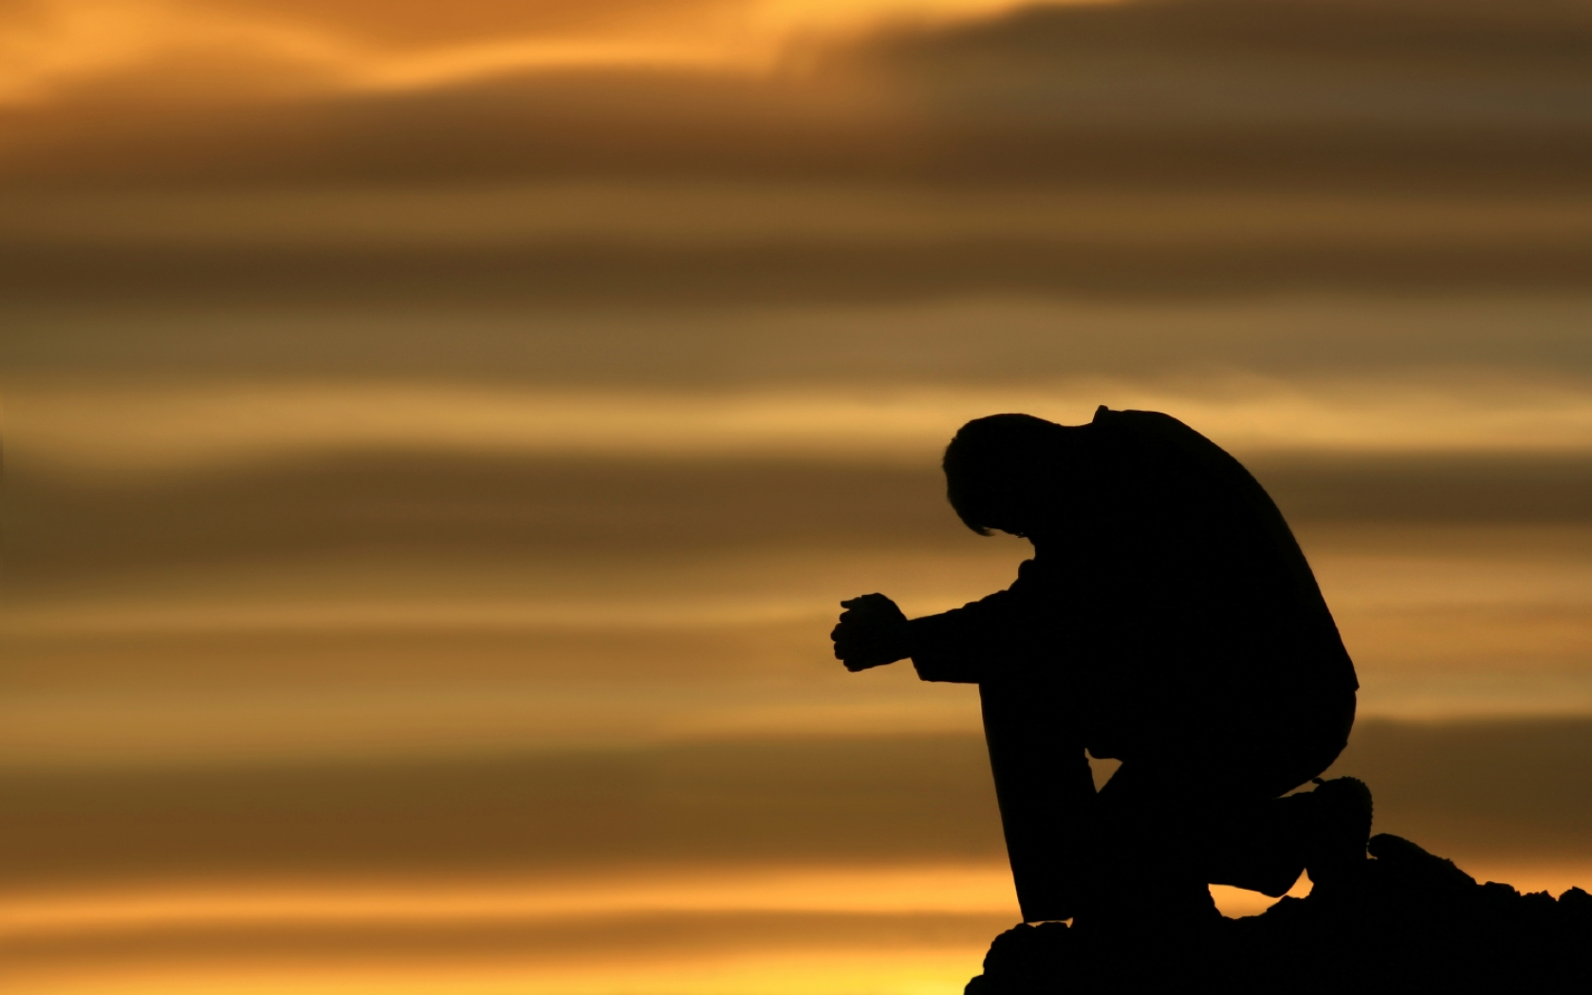
Prayer

Slide 3


Slide 4

Set April Date

Slide 5
And take the helmet of salvation, and the sword of the Spirit, which is the word of God;
Ephesians 6:17 NKJV

Slide 6
Why do you think Paul made the helmet salvation?

Slide 7
What is the purpose & overarching theme of the bible?

Slide 8
Salvation
Soteriology - The study of salvation.

Slide 9
What is salvation, & how do we receive it?

Slide 10
What are some ways we can identify those who have been saved?

Slide 11
THEIR FRUIT
Also, do they knowingly transgress God’s word and have no appearance of repentance.

Slide 12
How does sin affect us before & after salvation?
Notes:
We can no longer sin in terms of judgement, since we are no longer under the law.
However, we still sin in our relationship with God. Thus we loose or gain power, or standing with God.

Slide 13
Can you lose your salvation?

Slide 14
For it is impossible for those who were once enlightened, and have tasted the heavenly gift, and have become partakers of the Holy Spirit, and have tasted the good word of God and the powers of the age to come, if they fall away, to renew them again to repentance
Heb 6:4-6a NKJV

Slide 15
Why can’t they be renewed again to repentance?

Slide 16
if they fall away, to renew them again to repentance, since they crucify again for themselves the Son of God, and put Him to an open shame.
Heb 6:6 NKJV
Notes:
He bore our pain & shame on the cross.

Slide 17
Can you reject your salvation?

Slide 18

“Therefore I say to you, every sin and blasphemy will be forgiven men, but the blasphemy against the Spirit will not be forgiven men. Anyone who speaks a word against the Son of Man, it will be forgiven him; but whoever speaks against the Holy Spirit, it will not be forgiven him, either in this age or in the age to come.
Matt 12:31-32

Slide 19
For the gifts and the calling of God are irrevocable
Rom 11:29 NKJV
Notes:
Rom 11:28-32 - Concerning the gospel they are enemies for your sake, but concerning the gospel they are enemies for your sake, but concerning the election they are beloved for the sake of the fathers. 29 For the gifts and the calling of God are irrevocable. 30 For as you were once disobedient to God, yet have now obtained mercy through their disobedience, 31 even so these also have now been disobedient, that through the mercy shown you they also may obtain mercy. 32 For God has committed them all to disobedience, that He might have mercy on all.
This is talking about how the gentiles have received the promise & gift of salvation promised to the Jews, because they did not accept their Messiah.

Slide 20
What does “irrevocable” mean?

Slide 21
Irrevocable - ἀμεταμέλητος (ametamelētos)
1.) Not to be repented of
2.) About which no change of mind can take place
3.) Not affected by change of mind
Souter, A. (1917). A Pocket Lexicon to the Greek New Testament (p. 15). Oxford: Clarendon Press.

Slide 22
Helmet - περικεφαλαία (perikephalaia)
Used twice
1.)Eph 6:17
2.) 1Th 5:8 - But let us who are of the day be sober, putting on the breastplate of faith and love, and as a helmet the hope of salvation.

Slide 23
What does a helmet protect?

Slide 24
The head & neck

Slide 25
The helmet was originally of skin, strengthened with bronze or other metal, and surmounted with a figure adorned with a horsehair crest. It was furnished with a visor to protect the face.

Slide 26
The iron helmet was forged from one piece of metal and lined with leather. Crests made of dyed horsehair indicated rank. Plates hung down along the cheeks and another plate protected the back of the neck and shoulders.

Slide 27
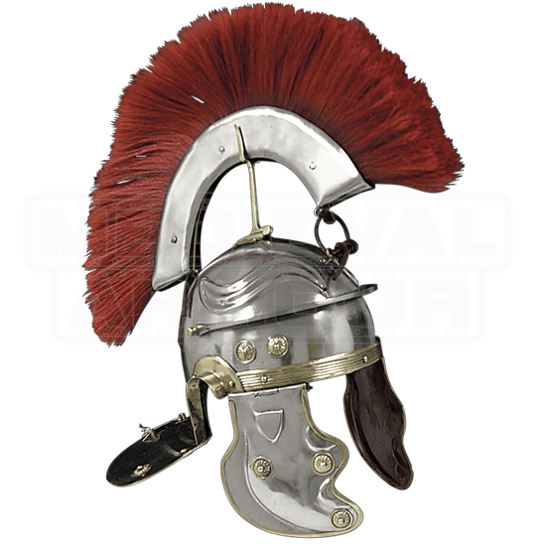

Slide 28
And take the helmet of salvation,...
Eph 6:17a NKJV

Slide 29
What would the word take imply to us?

Slide 30
Take - δέχομαι (dechomai)
Used 62 times in NT.

Slide 31
35 times = “to receive” as a person - verb - to willingly permit access to one’s company.

Slide 32
10 times = “to accept” - verb - to react favorably to, & thus consider right & proper.

Slide 33
10 times = “to receive” - verb - to get something or come into possession of; whether physical or abstract.

Slide 34
4 times = “to take” physically - verb - to get into one’s hands or take physically.
(Eph 6:17 chose this translation)

Slide 35
2 times = “to accept” knowledge - verb - to consider or hold as true.

Slide 36
Possible NKJV Translations
And take the helmet of salvation
And receive the helmet of salvation
And accept the helmet of salvation
NLT - And put on salvation as your helmet
Notes:
Take is NKJV, KJV, ESV, NIV
The message leaves it out all together just listing things.

Slide 37
Which one is the correct translation to you?

Slide 38
Why do you think Paul made the helmet salvation?

Slide 39
What’s next?
Belt, Sword or Spear?

Slide 40
Prayer

