Slide 2
The Sword of the Spirit

Slide 3
Set July Date

Slide 4
Down to meet

Slide 5
Prayer

Slide 6
Eph 6:17 - “…, and the sword of the Spirit, which is the Word of God;”
NKJV

Slide 7
Why is the bible called “The Sword of the Spirit”?

Slide 8
Can you name any ways you’ve used the bible as a Sword?

Slide 9
What would you say if someone asked you why you believe the bible is true?

Slide 10
From a historian perspective ancient texts are evaluated generally by 3 criteria;
1.) How many copies of the text do we have?
2.) How far from the original writing/event were the copies made?
3.) How closely do the copies reflect the originals?

Slide 11
What do you think?
Looking at only the New Testament.

Slide 12
How many copies,
how far from the original event,
& how closely do the copies match?

Slide 13
How do you think the New Testament compares to other famous books of history?

Slide 14
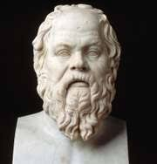
Plato
Written 427-347 b.c.,
Earliest Copy - 900 a.d.,
Time Span = 1,200yrs,
Number of copies - 7,
Accuracy of copies - Low

Slide 15
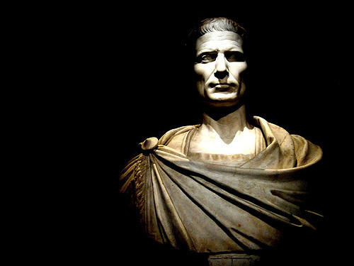
Caesar
Written 100-44 b.c.
Earliest Copy - 900 a.d.
Time Span = 1,000yrs
Number of copies - 10
Accuracy of copies - Low

Slide 16
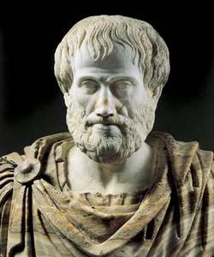
Aristotle
Written 384-322 b.c.
Earliest Copy - 1,100 a.d.
Time Span = 1,400yrs
Number of copies - 49
Accuracy of copies - Low

Slide 17
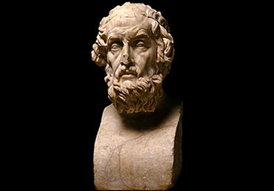
Homer (Iliad)
Written 900 b.c.
Earliest Copy - 400 b.c.
Time Span = 500yrs
Number of copies - 643
Accuracy of copies - 95%

Slide 18
With this in mind do you want to change any of your numbers you guessed before?

Slide 19
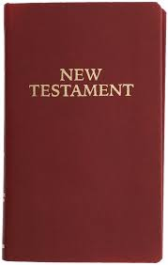
New Testament
Written 50-100 a.d.
Earliest Copy - 130 a.d.
Time Span = 30 to 80yrs
Number of copies - 5,600
Accuracy of copies - 99.5%
Notes:
The 0.5% comes from damaged scrolls that can’t be confirmed. Keep in mind this is original language to original language. This is not original language to English etc.

Slide 20
Why is the New Testament so accurate?
The Old Testament is also amazingly accurate because of how it was copied. It was a process unlike any other book in history.

Slide 21
Jewish scribes solidified the following process for creating copies of the Torah and eventually other books in the Old Testament.
1.) They could only use clean animal skins, both to write on, and bind manuscripts.
2.) Each column of writing could have no less than 48, and no more than 60 lines.
3.) The ink must be black, and of a special recipe.

Slide 22
Jewish scribes solidified the following process for creating copies of the Torah and eventually other books in the Old Testament.
4.) No word or single letter could be written from memory. A scribe must have another scroll open before him & must verbalize each word aloud while they were writing.
5.) They must wipe the pen and wash their entire bodies before writing the word "Jehovah," every time they wrote it.
6.) There must be a review within 30 days, and if as many as 3 pages required any corrections, the entire manuscript (book) had to be redone.

Slide 23
Jewish scribes solidified the following process for creating copies of the Torah and eventually other books in the Old Testament.
7.) Every letter had to have some space around it. If one letter touched another or if a letter was defective because of incorrect writing, a hole, a tear, or a smudge so that it could not be easily read, the entire scroll was invalidated.
8.) The letters, words, and paragraphs had to be counted, and the document became invalid if 2 letters touched each other. The middle paragraph, word and letter must correspond to those of the original document.
9.) The documents could be stored only in sacred places (synagogues, etc).

Slide 24
Jewish scribes solidified the following process for creating copies of the Torah and eventually other books in the Old Testament.
10.) As no document containing God's Word could be destroyed, they were stored, or buried, in a genizah - a Hebrew term meaning "hiding place." These were usually kept in a synagogue or sometimes in a Jewish cemetery.

Slide 25
In case you were wondering, the Torah (Pentateuch) has;
304,805 letters
79,976 words in Hebrew
“Jehovah” is found 6,828 times.

Slide 26
With any weapon you must train, how do we train to use the bible as a weapon?

Slide 27
What type of sword do you see the bible as being?

Slide 28
This?

Slide 29
The word used is “μάχαιραν” (machaira)

Slide 30
The machaira was classified as a large knife or small sword.
It’s also referred to as a dagger.

Slide 31
Machaira

Slide 32
The machaira was used for close in battle.
It’s blade was generally between 20 & 24 inches.

Slide 33
If you were to stick anything 12-24 inches inside the human body, either from the front, back or side you would most likely hit something that was needed to continue life.
Some were straight blades for cutting & slashing, some had curved blades for slashing attacks.

Slide 34
How did Jesus use use the sword?

Slide 35
When He was tempted in the desert by the Devil, He used 3 verses, all found in 1 book & out of 2 chapters;
1.) Deut 8:3 - Hunger - “...man shall not live by bread alone; but man lives by every word that proceeds from the mouth of the LORD.” FYI LORD = Jehovah
2.) Deut 6:16 - The pinnacle of the temple - “You shall not tempt the LORD your God...”
3.) Deut 6:13 - On the mountain - “You shall fear the LORD your God and serve Him, and shall take oaths in His name.”

Slide 36
There are 3 different words used for “The Word”, & they mean 3 very different things.
1.) Gaffe - A book, this doesn’t mean your bible it means a book, any book.
Comes from the word for quill & is where we get the word graphite (pencil lead)
This sword is just a long piece of unsharpened metal. Not going to help much.

Slide 37
The 3 different words used for “The Word”
2.) Logos - The Word of God, this is The Bible.
Getting closer - this is a “sword” with a dull blade. It can help, but it’s not going to kill the enemy.
You won’t get far fighting pride with Jn 11:35 - Jesus wept.
Notes:
even worse would be to fight the temptation of lust with - Sos 4:5 - Your two breasts are like two fawns, Twins of a gazelle, Which feed among the lilies.

Slide 38
The 3 different words used for “The Word”
3.) Rhema - A word from God to you personally through His Word.
This is a sharp sword! This is what Jesus did. He pulled a sword out that dealt exactly with His current situation.
But to do this means YOU HAVE TO KNOW THE WORD BEFORE THE BATTLE.

Slide 39
How ready are you for the fight?

Slide 40
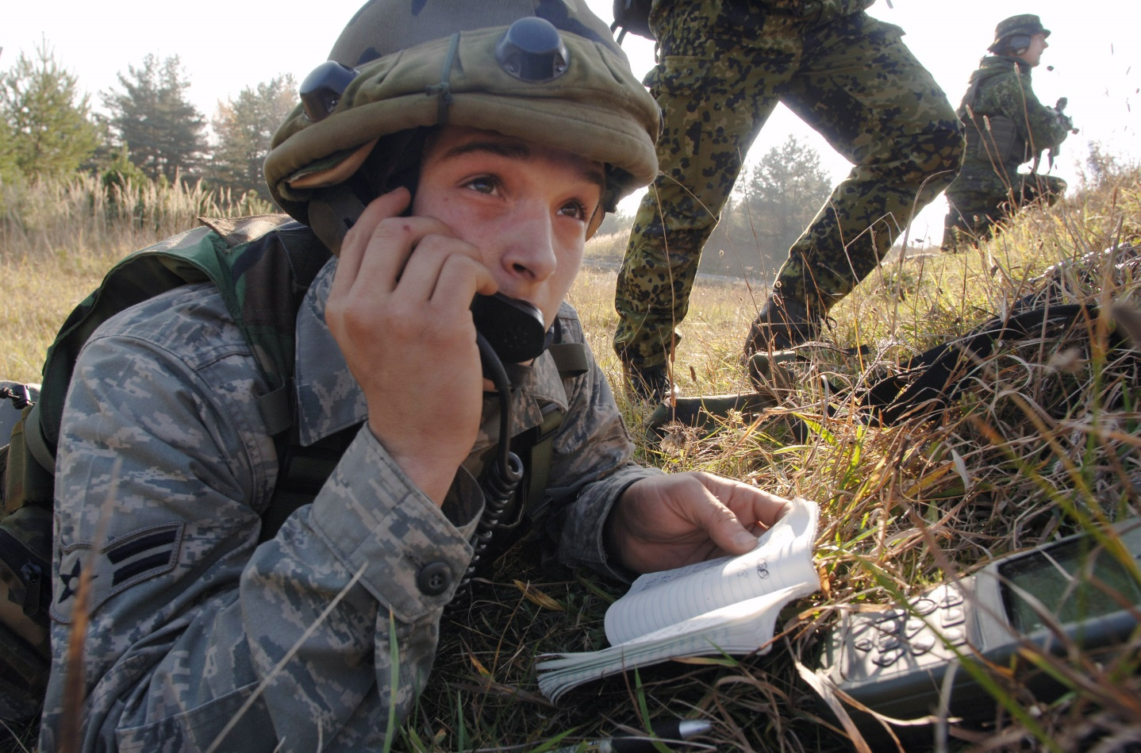
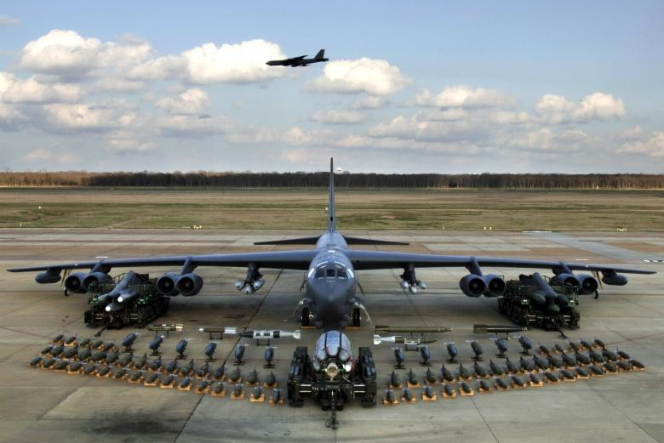
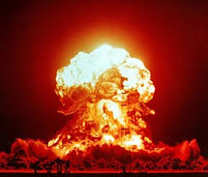
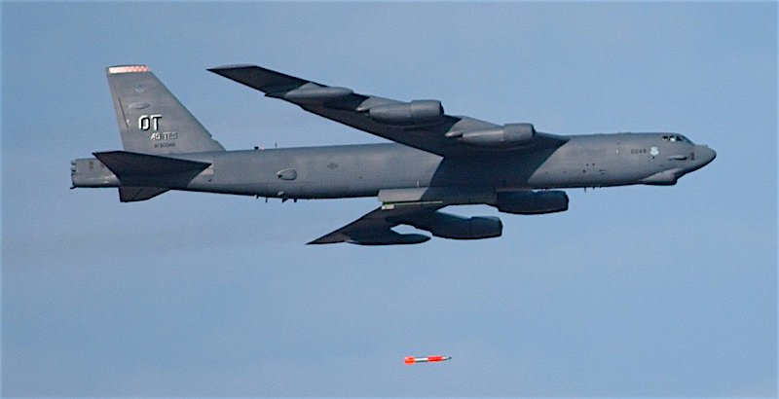
Knowing the bible is like having all the assets of the military at your disposal at any time. If you know what they are & what they are used for, you can direct them on target with surprising results.

Slide 41
If you study the Old Testament you will get a good idea of the tactics and “attack formations” of the enemy. Seeing the attack coming gives you times to unsheathe the right sword and prepare for the battle!

Slide 42
We want to swing hard from the start & hit the target each time. If it took Jesus 3 swings, it’s going to take us many more.
But, if we swing with solid strikes we will win sooner.
If we are like a crazy person swinging madly, we will tire & get crushed.

Slide 43
What are some of your favorite “battle verses” in the bible?

Slide 44
How will you sharpen your sword this month?

Slide 45
Have you worked on your Shield of Faith?
Have you tied your Shoes of the Gospel of Peace?
Are you wearing the breastplate of Rightousness?

Slide 46
Which do you most resemble?

Slide 47
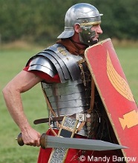
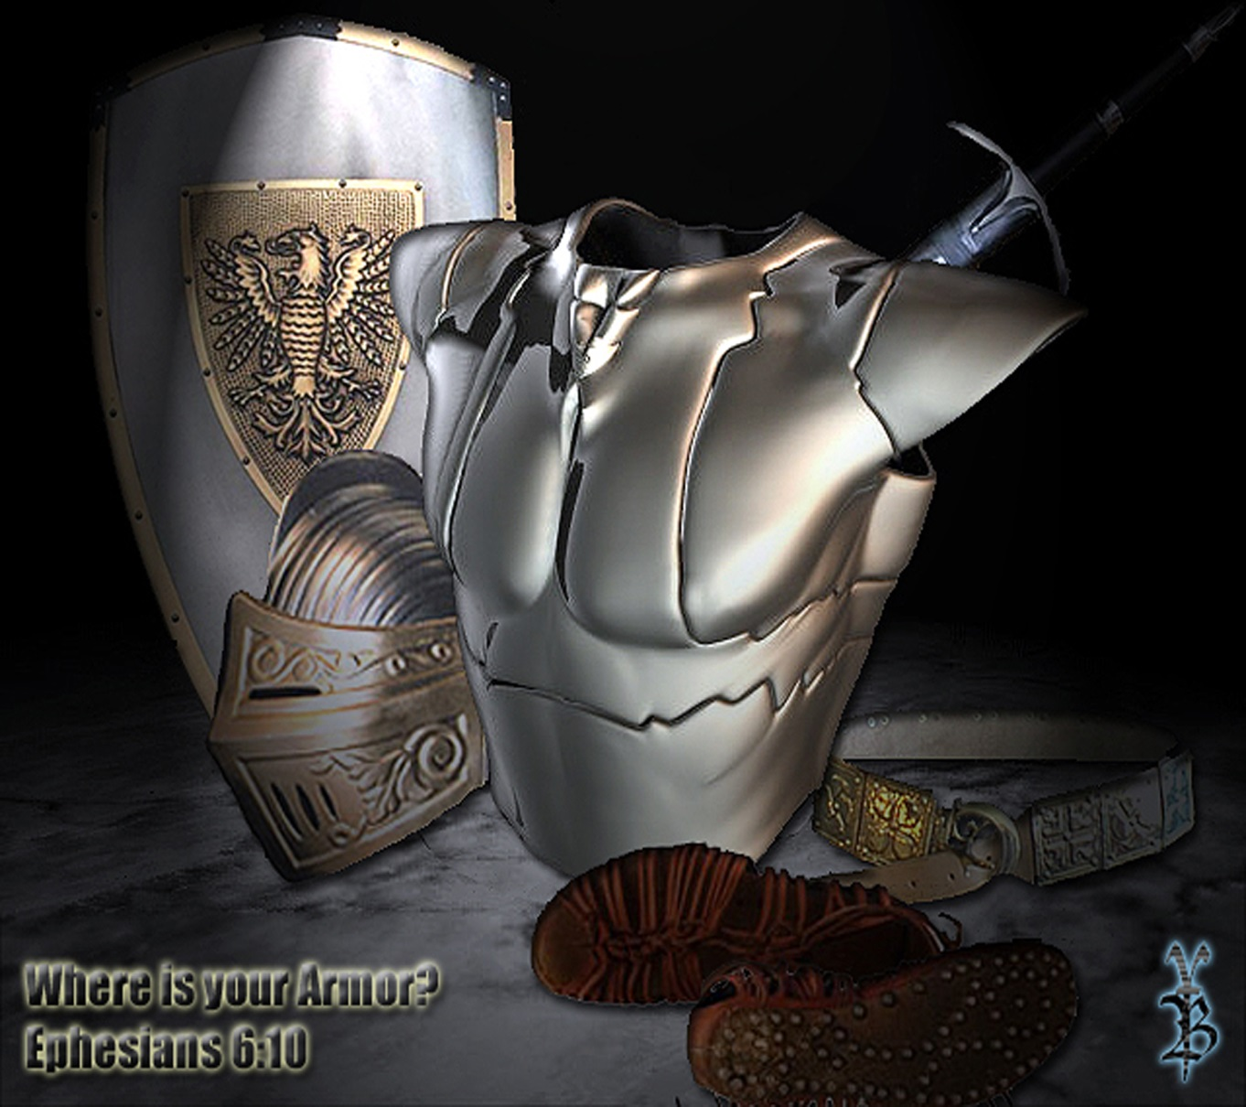
ARMOR AT HOME, OR
READY FOR BATTLE?

Slide 48
Questions, Comments?

Slide 49
Prayer

