Slide 2
Prayer
Notes:
Me, standard.

Slide 3
Set date for January 2020

Slide 4
Voice of the martyrs
Notes:
Kits

Slide 5
What is Christmas to you?

Slide 6
What about the Christmas story speaks to you the most?
Notes:
Kenosis – That Jesus left heaven, giving up power & knowledge to be a man.

Slide 7
How did people know Jesus was the Christ child?
The location of his birth – Micah 5:2 KJV
“But you, Bethlehem Ephrathah, Though you are little among the thousands of Judah, Yet out of you shall come forth to Me The One to be Ruler in Israel, Whose goings forth are from of old, From everlasting”
His blood line – Isaiah 11:1 KJV
“There shall come froth a Rod from the stem of Jesse, And a Branch shall grow out of his roots.”
Notes:
Prophesy – They knew it. Just as we should know it today, to see the signs of his appearing – not return

Slide 8
Did Jesus have to come & suffer?
Notes:
He is God, couldn’t He just save us?

Slide 9
The wages of sin is death,
but the gift of God eternal life
in Christ Jesus our Lord.
Rom 6:23

Slide 10
What would you sacrifice for someone?
Notes:
Loved one
Friend
Stranger
Enemy
*If life – like Moses (take my salvation) or just here?

Slide 11
How do we picture Jesus?

Slide 13
What does the bible say He looked like?

Slide 14
He has no form or comeliness; And when we see Him, There is no beauty that we should desire Him.
Isaiah 53:2
NKJV
Notes:
Form = stately
Comeliness = splendor

Slide 15
Notes:
4 guys with knives, take a man into a room & cut out his heart. Several people stand outside the door, able to stop it, but they did nothing.
Surgeons

Slide 16
Prior to His birth, how do you picture Joseph & Mary going to & in Bethlehem?

Slide 18
Notes:
Mary was a 14-16yr old girl near the end of her pregnancy. Told she has to take a 7-9 day journey on foot/donkey through the woods, hills etc just so they can be counted. Today it would take us about 1hr 45min by car.
O by the way when we get there, there’s probably not going to be room at my families house. Family I haven’t either seen in forever or ever. Then they arrive & can’t find a place to stay so we are going to stay in a barn (actually a cave) with animals. And this is where you will have your baby.

Slide 19
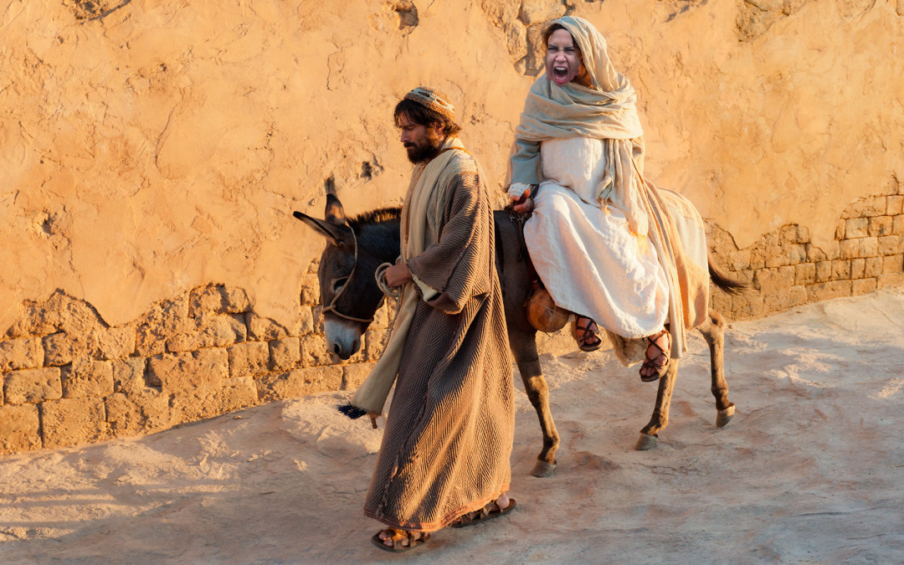

Slide 20
What could a change of perspective do for us?
Notes:
Is Christmas a gift, or an opportunity.
What type of opportunity could Christmas give us?

Slide 21
After Christmas is the new year - What will you resolve?
(asked in 2018)

Slide 22
What has changed in 2019?

Slide 23
I have been crucified with Christ; it is no longer I who live, but Christ lives in me; and the life which I now live in the flesh I live by faith in the Son of God, who loved me and gave Himself for me.
Galatians 2:20
As you therefore have received Christ Jesus the Lord, so walk in Him, rooted and built up in Him and established in the faith, as you have been taught, abounding in it with thanksgiving. Beware lest anyone cheat you through philosophy and empty deceit, according to the tradition of men, according to the basic principles of the world, and not according to Christ.
Colossians 2:6-8
Notes:
1 – If I’m dead & live by faith, why do I care so much about how I’m viewed in the world?
2 – rooted & built up = basing everything on & going off of Him.
Beware – this is huge it’s a call to pay attention
Through philosophy & empty deceit = reason without biblical standing & lies
Tradition of men – a deep look into our most basic traditions will start to make you wonder, I’ll leave it at that.
The basic principles of the world – our desires, the flesh, worry, fear.

Slide 24
For the flesh lusts against the Spirit, and the Spirit against the flesh; and these are contrary to one another, so that you do not do the things that you wish.
Galations 5:17
Notes:
Rev 3:14-22???

Slide 25
The gift of mistakes, the freedom of forgiveness & the opportunity of faith.
Notes:
mistakes - We learn from them, loose pride gain humility
forgiveness - to be forgiven is to learn to forgive. And to forgive others, is to forgive ourselves.
Faith - The opportunity of eternity stands before us all. Right now we can invest in the world, or heaven; but not both.

Slide 26
Presents
What gift would you like to give Jesus this Christmas?
What gift does Jesus want from you this Christmas?
Notes:
When Jesus opens His gift from you, this is what He wants – All your pride, lust, idolatry, pain, insecurity, selfishness, substance abuse ect.
And His gift is love, acceptance & eternal life.

Slide 27
What is your true focus for Christmas?

Slide 28
All things related to Christmas is good to celebrate, if we do it the right way!
Bring the focus to Jesus & His birth, through all the symbols & traditions.
There may not be a better time to reach the unsaved!
Notes:
This is the time when people are most open to hearing the “Christmas story” which opens us to sharing the gospel. Even if we don’t agree with how it is celebrated by the world, we can use it to reach them.
We should be most afraid of letting Christmas go by & not talk about Jesus with the world. That would be sinful.
Read Matt 1:18-2:18 to your family in your house & make that the focus of your Christmas, this truth of what we celebrate & the reason for the season.
Where it says that the word of the prophet may be fulfilled, go there and read it to your family so they know.

Slide 29
So don’t let anyone condemn you for what you eat or drink, or for not celebrating certain holy days or new moon ceremonies or Sabbaths. For these rules are only shadows of the reality yet to come. And Christ himself is that reality.
Col 2:16-17 NLT

Slide 30
For though I am free from all men, I have made myself a servant to all, that I might win the more; and to the Jews I became as a Jew, that I might win Jews; to those who are under the law, as under the law, that I might win those who are under the law; to those who are without law, as without law (not being without law toward God, but under law toward Christ), that I might win those who are without law; to the weak I became as weak, that I might win the weak. I have become all things to all men, that I might by all means save some. Now this I do for the gospel’s sake, that I may be partaker of it with you.
1 Cor 9:19-23 NKJV

Slide 31
Let’s Look at the truth behind the Christmas today.

Slide 32
When was Jesus born?
Sometime between April & Sept in 3-4 a.d.
Notes:
Shepherds in the fields
Long journey for many for the census in the winter would have killed many.

Slide 33
Where are we told to celebrate Christmas?
NOWHERE
Jesus only commands us to do 1 thing in remembrance of Him.
Communion – Lk 22:19-20.
Notes:
Nowhere does God command us to celebrate Christmas.
Communion – There are no dates or seasons or amount of times we should do this either.

Slide 34
What is Hanukkah?
Festival of Light
From the 1st century revolt of the Maccabee family against Antiochus IV Epiphanes (the king) to take back the temple.
They found 1 jar of oil (enough for 1 day) & it lasted 8. Enough time to make the needed oil to burn the lamps in the temple.
Notes:
After – Why do we care about Hunakkah?

Slide 35
Jesus went to Jerusalem during the feast of Hanukkah.
This would have been a 6 week journey for Him. Recorded in Jn 10:22-42

Slide 36
So where does Dec 25th come from?
Dionysius Exiguus a Scythia monk set they year of Christ’s birth.
Roman calendar based on the year the city of Rome was founded - AUC
Jesus lived 15yrs under Cesar Augustus & 15yrs under Cesar Tiberius.
Notes:
Exiguus = The humble one
Scythia = Modern day Romania N.E. of the Black Sea

Slide 37
So where does Dec 25th come from?
Cesar Augustus took power in 727 AUC
Dionysuis put Jesus’ birth at 754 AUC
But Lk 1:5 puts Jesus’ birth during the reign of Herod the Great who died in 4-3 B.C. or 750 AUC

Slide 38
So where does Dec 25th come from?
The Paca Computus written in Northern Africa near 243 AD says Jesus was born March 28th 3 AD
Clement the Bishop of Alexander set Jesus’ birth in November of 18 AD
Joseph Fitzmeyer says Jesus was born on
Sept. 11th 3 B.C.
Notes:
Paca Computus – written in Northern Africa near 243 AD says Jesus was born March 28th 3 AD
Fitzmeyer – Catholic school in US

Slide 39
So where does Dec 25th come from?
It was set by Constantine in 312 AD to “Christianize” the Pagans.
It was the Pagan holiday Saturnaila & making it Jesus’ birthday would put “something” Christian in it
What was the holiday of Saturnaila?

Slide 40
The Pagan Holiday of Saturnaila
Started in 497 BC when the Roman temple of Saturn was dedicated in Rome
Saturn was the Roman god of fertility & agriculture.
The female side was Asherah, Ashtoreth & Ishtar, Venus, Aphrodite…
Notes:
The holiday represented in 1 Kings as the worship of Baal & Asherah during the time of King Ahab & the Prophet Elijah.
Asherah Pole in OT.
Asherah, Ashtoreth & Ishtar = Seriramis – wife of Nimrod. Thus Nimrod is Saturn

Slide 41
The Pagan Holiday of Saturnaila
Started as a 1 day holiday but grew until it went from Dec 17 to Dec 25th.
It was a time where lawlessness was celebrated.
(The mystery of lawlessness already at work) 2Thes 2:7
It began when Roman authorities chose an “enemy of the Roman people”. Could be male or female.
Notes:
#2 - The Roman courts were closed & no one could be punished for damaging property or injuring people.
#3 – They would be forced to indulge in food & other physical pleasures during the week, then brutally murdered on Dec 25th. This was seen as killing the evil inside Rome.

Slide 42
The Pagan Holiday of Saturnaila
Lucian, Greek historian, wrote in the 2nd century about this holiday.
They would go house to house singing while naked.
They would eat human shaped biscuts.
Notes:
# 1 – Spoke of human sacrifice & wide spread drunkenness, rape & other sexual license. Go to # 2
# 3 – Gingerbread men.

Slide 43
The Pagan Holiday of Saturnaila
Everyone including slaves looked forward to the holiday all year long.
Each house would elect a “King of Chas” or misrule to preside over the holiday.
Notes:
# 1 – Slaves could say whatever they wanted to their masters with no punishment. They would wear hats that represented they were free, so no one knew they were a slave.

Slide 44
HO HO HO
During Saturnalia people would yell Lo! Which became LO LO LO, which is where we get HO HO HO.
Notes:
# Christmas Tree – Male penis & wreath – Female vagina.

Slide 45
Saturnaila in the U.S.A.
In 1687 in Boston they observed the 1st nativity, but stated “This isn’t Jesus’ birthday.”
The Puritans refused to celebrate Christmas & 1659-1681 Christmas was outlawed in Massachusetts. Because of it’s Pagan links to Saturnaila.

Slide 46
Saturnaila in the Jewish World
In 1466 Pope Paul II forced Jews to eat a lot of food then run naked in the streets, reportedly laughing heartily during.
In the 18th & 19th century Rabbi’s were made to walk the streets of Rome in clownish outfits while people threw things at them.

Slide 47
Saturnaila in the Jewish World
In 1836 Jews petitioned Pope Gregory 16th – begging him to stop the holiday of Saturnaila.
He denied & that year 12 Jews were murdered & many Jewish women raped.
Jews today remember these atrocities and tend to more tie Dec 25th with Saturnaia then the birth of Christ, which they also know it celebrates.

Slide 48
Christmas Tree
Related to the Asherah Pole, people who worship trees. Germans hung them upside down.
The church tried to recruit Pegans why allowing people to decorate the trees.
Notes:
# Christmas Tree – Male penis & wreath – Female vagina.

Slide 49
Christmas Tree
Hear the word that the Lord speaks to you, O Israel! This is what the Lord says: “Do not act like the other nations, who try to read their future in the stars. Do not be afraid of their predictions, even though other nations are terrified by them. Their ways are futile and foolish. They cut down a tree, and a craftsman carves an idol. They decorate it with gold and silver and then fasten it securely with hammer and nails so it won’t fall over.
Jeremiah 10:1-4 NKJV
Notes:
# Christmas Tree – Male penis & wreath – Female vagina.

Slide 50
So don’t let anyone condemn you for what you eat or drink, or for not celebrating certain holy days or new moon ceremonies or Sabbaths. For these rules are only shadows of the reality yet to come. And Christ himself is that reality.
Col 2:16-17 NLT

Slide 51
For though I am free from all men, I have made myself a servant to all, that I might win the more; and to the Jews I became as a Jew, that I might win Jews; to those who are under the law, as under the law, that I might win those who are under the law; to those who are without law, as without law (not being without law toward God, but under law toward Christ), that I might win those who are without law; to the weak I became as weak, that I might win the weak. I have become all things to all men, that I might by all means save some. Now this I do for the gospel’s sake, that I may be partaker of it with you.
1 Cor 9:19-23 NKJV

Slide 52
The challenge
Make Christmas about Christ
How many pairs of clean animals, birds & unclean animals did Noah take on the ark?
1 unclean, 7 clean & 7 birds. Gen 7:2-3
In 2020 learn the Biblical Truth, not the
Sunday School truth.
Notes:
To become reckless in your faith & devotion to God. To not gauge your success or worth on what others say you have or are; but instead on the measure of your Creator.
Take hold of the opportunity of His birth & make this the time you know Him better than ever.

Slide 53
Closing Prayer
Notes:
Around the room.

