Slide 1

The Tactics of the enemy

Slide 2
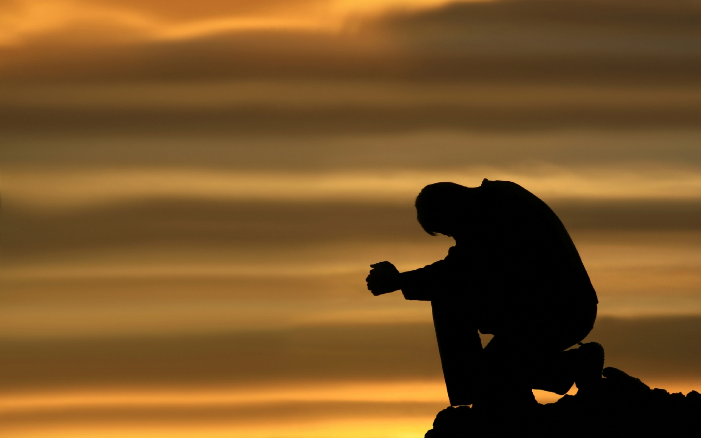
Prayer

Slide 3

Set Nov date & food
Changes to downtomeet.com
If there was a lesson to side track, ask questions & dig, it is this one.
Notes:
Changes to downtomeet.com
Forum – Prayer Requests
Files – PowerPoints
We will review the key points of last month, finish our study on the Armor of God & then look at where we can get closer to God in our own lives. This lesson isn’t to make you feel good, it’s to tell you the truth.
Slide - 6

Slide 4

tac•tics \ˈtak-tiks\ from Greek taktika,
1 a: the science and art of disposing and maneuvering forces in combat
b: the art or skill of employing available means to accomplish an end
2: a system or mode of procedure
3: the study of the grammatical relations within a language including morphology and syntax
Merriam-Webster, I. (2003). Merriam-Webster’s collegiate dictionary. (Eleventh ed.). Springfield, MA: Merriam-Webster, Inc.ouncements

Slide 5
“If you know the enemy & know yourself, you need not fear the result of a hundred battles. If you know yourself but not the enemy, for every victory gained you will also suffer a defeat. If you know neither the enemy nor yourself, you will succumb in every battle.”
Sun Tzu, The Art of War

Slide 6
Who is our enemy?
Notes:
Satan, Devil, Demons
Slides 6-12

Slide 7
Lucifer - The name given to him at his creation.
Notes:
What does it mean?

Slide 8
In the bible, names mean a lot, so what does his name mean?

Slide 9
Meaning: Shining one, Son of the morning or morning star.
Notes:
What did he look like before his fall?

Slide 10
Description: Ezk 28:12-19

Slide 11
He was the seal of perfection - full of wisdom & perfect in beauty
He was covered/studded with every precious stone.
His fingertips had drums or cymbals
Pipes came from his sides
In place of vocal cords he had pipes

Slide 12
Job Assignment:
He was the covering cherub, the only thing physically above God.
He walked in the midst of the fiery stones
He was perfect in his ways
Notes:
Slide - 16

Slide 13
What happened when he was cast down?
He was devoured by fire from the inside out.
So I brought fire out from within you, and it consumed you. I reduced you to ashes on the ground in the sight of all who were watching.
(Ezk 28:18)

Slide 14
Only his beauty was taken away, not his wisdom!

Slide 15
What was his name changed to?

Slide 16
Satan, what does it mean?
Meaning: Adversary or opposer - Lk 10:18

Slide 17
Devil is also another name he goes by now. What does it mean?
Meaning: Accuser or slander

Slide 18
Any other names?
The god of this world
The prince of the power of the air
The great red dragon - this is why people think he wears red.
The serpent of old - his deception in the garden of Eden.
Notes:
A dragon is basically a serpent on steroids.
Slide - 25

Slide 19
Is it easy to tell him/them (demons) apart from angelic spiritual beings?

Slide 20
But I am not surprised! Even Satan disguises himself as an angel of light. So it is no wonder that his servants also disguise themselves as servants of righteousness...
2Cor 11:14-15a NLT

Slide 21
But even if we, or an angel from heaven, preach any other gospel to you than what we have preached to you, let him be accursed. As we have said before, so now I say again, if anyone preaches any other gospel to you than what you have received, let him be accursed.
Gal 1:8-9

Slide 22
Then how are we to know who to trust?

Slide 23
Dear friends, do not believe everyone who claims to speak by the Spirit. You must test them to see if the spirit they have comes from God. For there are many false prophets in the world. This is how we know if they have the Spirit of God: If a person claiming to be a prophet acknowledges that Jesus Christ came in a real body, that person has the Spirit of God. But if someone claims to be a prophet and does not acknowledge the truth about Jesus, that person is not from God...
1Jn 4:1-3a NLT

Slide 24
So I want you to know that no one speaking by the Spirit of God will curse Jesus, and no one can say Jesus is Lord, except by the Holy Spirit.
1Cor 12:3 NLT
Notes:
This means a true statement. Not just words.

Slide 25
Now that we know who our enemy is & how to ID them, what is the battle truly over?
Souls
No, that’s a means to an end.
Everything the satan does is ultimately directed to/at God. So what’s the fight over?
It’s all over GLORY!!!!
It’s over what he wanted in heaven
Notes:
Human souls choosing hell over the sacrifice of Jesus, this is the only way Satan can hurt God.
SLIDE - 62

Slide 26
Where in the bible do we see how the spiritual realm operates, best?
Job
Cliff notes of Job 1-2
Notes:
Job 1-2 is like having the curtain of heaven pulled back so we can see how the real world works.

Slide 27
Job 1:6 - Angels come before the thrown of God, the satan is also there. Don’t miss this, the angels are gathered before the thrown of God. These are the good guys & then satan. God calls out Satan asking him where he’s been. He responds that he has been walking upon the earth.

Slide 28
Job 1:12-19 - God gives the satan permission to “test” Job. But God gives him parameters that he MUST follow. Satan is not free to do as he pleases, he must work within the confines given. God does allow things to happen, but they always are for HIS GLORY!
Notes:
A few things. 1. Satan knows his limits & stays within them. 2. God doesn’t tell Satan what to do to Job to “test” him, he does that on his own.

Slide 29
Now begins the
“Succession of sorrow”
With permission to touch everything but Job himself Satan goes with fury to destroy Job’s allegiance to God. How does he do this, by destroying the people & things Job loves;

Slide 30
His oxen & donkeys are taken & all his servants killed, but one.
Fire from heaven comes and burns up sheep & servants, all but 1 servant.
3 bands of raiders steal his camels and kill his servants.
His sons & daughters were killed in a building collapse due to high winds and 1 servant escapes.
Notes:
This one servant - just as all the rest are only spared to increase the devastation of the attack. By allowing one servant from each attack to return it allows all the news to arrive as a continuous drone of sorrow that continues to build to what is hoped to be a soul crushing experience. Chances are it was the least useful of the servants from that place that was able to return.
This is lightning, but it’s also blamed on God. We know that it’s from Satan. Satan is the great imposter, this is an important point to remember.
3 being important and another point of him being an imposter. In Revelation we see Satan will form an unholy trinity.

Slide 31
With all of this what did Job do?

Slide 32
Job 1:20-22 - Despite all this, Job humbles himself and worships God. He sees all of his loss and he udders some profound words of centering...
And he said: “Naked I came from my mother’s womb, And naked shall I return there. The LORD gave, and the LORD has taken away; Blessed be the name of the LORD.”
Job 1:21 NKJV

Slide 33
Despite all of his loss, all of his pain, all of what has happened to him we see Job 1:22 - Job does not sin or charge God with wrong.
Battle won, war over.
Wrong!

Slide 34
Job 2:1-10 - The angels gather and the satan is again there. Having failed his first mission he is back for a second. God is glorified and shows Satan that He was glorified by saying something interesting; God says in Job 2:3 - “although you incited Me against him, to destroy him without cause.”
Notes:
At first glance this looks like God Himself has struck Job, but the truth is God did not touch His servant Job, Satan did.

Slide 35
Job 2:4-5 - Satan launches his second mission; allow me to touch him, no man will suffer himself without cursing You. God allows his request but tells Satan he can’t take Job’s life.

Slide 36
After striking Job with painful boils from head to toe (Job 2:7), he sends Job’s wife to tempt him (Job 2:9). Look at the words she uses, it is obvious that Satan is speaking through her.
Then his wife said to him, “Do you still hold fast to your integrity? Curse God and die!”
Job 2:9 NKJV

Slide 37
Job calls out the foolishness of her words, and speaks words of humility and wisdom (Job 2:10).
But he said to her, “You speak as one of the foolish women speaks. Shall we indeed accept good from God, and shall we not accept adversity?” In all this Job did not sin with his lips.
Job 2:10 NKJV

Slide 38
There is an important point to learn from what ISN’T written in those pages. It shows a limitation of the enemies power;
Satan can’t create anything, all he can do is manipulate & maneuver what’s been created.

Slide 39
Before we break down the tactics themselves, lets look at another of his favorite tactics;
GIVING

Slide 40
He’s not called the god of this world without reason.

Slide 41
Satan “owns” the earth & he didn’t buy it, he stole it. But he stole it fair & square, which is why God honors Satan’s temporary ownership of it.

Slide 42
Where & how did he get the deed to the earth?
The garden of Eden

Slide 43
Gen 3 - Eve is deceived and leads Adam to trespass, violating the “lease”.
We, as the rightful owners, transgressed the stipulations of the lease, and thus signed it over to Satan.
Notes:
Eve sinned, she was misled, Adam transgressed – he chose Eve over God. Men STILL choose women over everything.

Slide 44
This is why Jesus doesn’t deny Satan offering Him the world in Lk 4:6. It was a valid offer.
Notes:
It was blasphemy but it was a legitimate offer.

Slide 45
Remember though, when Satan gives you ANYTHING, he intends to take more than he gave.
It’s only after we have “bitten the fruit” of our desire that we realize it’s rotten.

Slide 46
What could be rotten fruit that we would bite today?
Sex outside of marriage
Alcohol
Drugs
Possessions
Position
Power

Slide 47
Satan will use more than 1 at a time!
This brings us to Esther.

Slide 48
A few things, if you haven’t read Esther recently

Slide 49
It’s the only book in the bible where God is never mentioned by name or title.
It’s essentially the opposite of Job.
Notes:
In Job the curtain is pulled back on the spiritual realm, in Esther it’s like our everyday life. The spiritual realm is hidden in plain sight.

Slide 50
Recap for Esther 1-3.

Slide 51
King Ahasuerus (Xerxes) has de-throned Queen Vashti for refusing to come to his party. He launched a Cinderella esque hunt for a new queen & Hadassah or Esther is selected...
Notes:
This is the king of the Persian empire which came against the Spartan 300 in the battle of Thermopylae. Vashti is removed before the battle & after the loss his servants launch the search as a way to lift his spirits.

Slide 52
Remember names mean something in the bible!
Hadassah means Myrtle, which is a flower. Something that will have to blossom to its full beauty and potential.
She is re-named Esther to protect her. Esther meaning; star, as she will be the star of this show.
Notes:
1.) Into Hadassah – Name at birth.

Slide 53
Esther becomes queen and now has great power, possessions & position. She now has servants.
A plot by Haman (means magnificent) is launched to destroy the Jews.
Now Esther is being called upon to save the Jews, but at the risk of her position, power, possessions & her life.
Notes:
2.) Often missed fact - Haman is an Agagite, from Agag. The city where God commanded Saul to destroy every living thing & he didn’t (1Sam 15:1). Thus Haman is able to rise up.

Slide 54
When a king of the Medo-Persian empire made a decree & sealed it with their signet ring, it could not be changed, even by the king. That would mean they made a mistake & the king was infalable.

Slide 55
Heman had convinced the king to set a day, which was picked by a lot, to murder the Jews and take all their possessions.
Esther would have to go to the king, without being called. If the king did not raise the golden scepter accepting her visit, she would be killed.
Notes:
1.) Heman did this because Esther’s uncle Mordecai wouldn’t bow to him. PRIDE. This has satan written all over it – 1.) Pride, 2.) Destruction of the Jews and more…

Slide 56
This is where a well known saying comes from; her uncle Mordecai sends Esther a message;
“Do not think in your heart that you will escape in the king’s palace any more than all the other Jews. For if you remain completely silent at this time, relief and deliverance will arise for the Jews from another place, but you and your father’s house will perish. Yet who knows whether you have come to the kingdom for such a time as this?”
Esther 4:13b-14 NKJV

Slide 57
The tactic was to keep Esther more focused on what she had to loose than what she was going to loose.
Fear gave way to acceptance.
Her people were saved, thus the feast of Purim which is celebrated every year.
Notes:
She saved her people & Heman was hung (just as Judas Mat 27:5 & Ahithophel 2 Sam 17:23)

Slide 58
How do these 2 different tactics apply to your life?

Slide 59
Some quotes from Tony Evans “Pathways”
“And the moment He (God) discovers you are unwilling to be used for His kingdom purposes, He can just as easily raise up someone else to replace you.” Pg 100
“God will never force you to fulfill your destiny. God will enable you to live out your purpose, but it’s up to you, through your choices & character, to remain in it.” Pg 100

Slide 60
Some quotes from Tony Evans “Pathways”
“He’s placed you where you are because you are in the midst of a battle, a war. You are in the midst of a seismic conflict involving Good vs Evil. You are in the midst of a feud for the spoils of lost souls. You are in your own David vs Goliath conflict, representing the Holy Spirit within you (Lk 3:22).” Pg 102
“To miss your kingdom assignment because you have become too caught up in your personal kingdom is the greatest tragedy you could ever face.” Pg 102

Slide 61
Some quotes from Tony Evans “Pathways”
“If your life isn’t focused on winning people to Christ, discipling them in the faith, & improving their lives in history so that they, too, can be greater vessels for God’s kingdom, then Mordecai’s words are directed to you as well.” Pg 102
“A turtle only makes progress when it sticks its neck out.” Pg 106

Slide 62
What would you say is Satan’s go to tactic?
DECEPTION

Slide 63
Deception consists of 4 steps.

Slide 64
1) Desire
And remember, when you are being tempted, do not say, “God is tempting me.” God is never tempted to do wrong, and he never tempts anyone else. Temptation comes from our own desires, which entice us and drag us away. These desires give birth to sinful actions. And when sin is allowed to grow, it gives birth to death.
James 1:14 NLT
Remember from “We Are All Addicts” - Enticed / Drawn away (ἐξελκόμενος) only used here in the bible. It’s a metaphor for hunting & fishing, as animals are enticed from a safe place to a snare, or fishing bait.

Slide 65
These can be legitimate desires leading to an illegitimate end
Ie, you meet a good need in a bad way.
What are some examples you can think of?

Slide 66
Our desires are God given, thus they will always be with you. But Satan wants your desires to be a master over you, not you master over them.
When our desires become master over us, they have a name
ADDICTION
Notes:
Addiction is when we weaponize our own instincts or an action.

Slide 67
Step 2) Deception
The moment the person takes the bait & knows they’ve been deceived.
Even if Satan is fishing, WE STILL HAVE TO BITE!

Slide 68
Step 3) Disobedience
Temptation comes from our own desires, which entice us and drag us away. These desires give birth to sinful actions. And when sin is allowed to grow, it gives birth to death.
James 1:14-15a NLT
The results of these actions may not show up for some time.

Slide 69
But the end result is;
Spiritual death & sometimes physical death.
James 1:14-16; Temptation comes from our own desires, which entice us and drag us away. These desires give birth to sinful actions. And when sin is allowed to grow, it gives birth to death. Do not be deceived, my beloved brethren.
Notes:
Sin and temptation are all based on DECEPTION. But to be deceived, most of the time you have to WANT to be deceived. At some point you will think, hear, feel or know something isn’t right; but, something inside of you will want or desire it more than doing the right thing.

Slide 70
Another tactic is DIVISION.
A few examples;
David & his wife Michal - 2Sa 6:14-23 (disgust)
Abram & Sarai through Hagar - Gen 16 (impatient)
Adam & Eve - Gen 3 (doubt)
Cain & Able - Gen 4:1-8 (jealousy)
Notes:
START EVERY SLIDE - NOV
David – She saw him dancing & despised him. (He never slept with her after this)
Abram – They though they had to make God’s promise come true. (All Arab nations track back to Ishmiel)
Adam – Adam had to choose between Eve & God.
Cain – Cain’s offering was not accepted & Able’s was (more to do with the heart than the gift). Cain brought fruit (garden) Able sheep (clothing from garden).
All of these were used against the family.

Slide 71
Here is where one of the scariest abilities of our enemy come into play;
They (satan & fallen angels ie demons) can put thoughts into our minds.
IMPORTANT NOTE: THEY CAN NOT HEAR OUR THOUGHTS, OR READ OUR MINDS!
This is the go to tactic for so many attacks & distractions.

Slide 72
If someone does something small or meaningless and all of the sudden you are thinking thoughts of “They did that on purpose” pay attention.
Notes:
Wives & Husbands, Parents & Kids, Co-workers. May be justified, but watch.

Slide 73
The 3rd tactic is DIVERSION.
I usually call this “distraction”.
It’s anything that can get you to either stop what your are doing, or move you on to something else.
Notes:
They are listed on the next slide.

Slide 74
Try reading the bible, or praying and you will get tired, hungry, have to use the bathroom, kids loose their mind, the phone rings, anything.
These are things that usually seem important at the time, but later you realize urgency was merely a clever pretender.
Notes:
Just like satan, urgency is usually an imposter of the truth.

Slide 75
After awhile of paying attention they will become very predictable.
Notes:
Don’t be afraid to call them out (out loud) or tell people before they happen that they will happen & why. Civic Center story, Wal-Mart Car story.

Slide 76
The last tactic we will look at is DISCOURAGEMENT.
Notes:
Thoughts like, then next slide.

Slide 77
Your not good enough, your not saved,
a real Christian wouldn’t do that,
God will judge you for that “insert sin of choice”.

Slide 78
With all these tactics there are generally 4 fronts on which we see the attacks coming.
1) The individual
2) The family
3) The church
4) Society
Notes:
All 4 next slide

Slide 79
Today the attacks are taking place on all 4 fronts at the same time with devastating results.

Slide 80
How do we fight these tactics?
Read your bible – the sword
Prayer – the spear

Slide 81
What’s the goal?
Knowledge - to know what is actually taking place
Training yourself to recognize what is happening
Have a war mentality
Remember Satan can’t create anything, all he can do is manipulate & maneuver what’s been created.
Notes:
2nd click - You are at war! If your in a war & don’t know your in a war – your fodder!

Slide 82
You can’t let your guard down you are in a war & real lives are at stake
But;

Slide 83
Even soldiers get “R&R”, so how do Christians?
BY PRAISING GOD!
When we praise God, God shows up to enjoy our praises & Satan must leave. So when you are attacked - praise Him!

Slide 84
Does this mean that everything will be okay if all I do is seek or praise the Lord?
Let’s look to Paul.

Slide 85
And lest I should be exalted above measure by the abundance of the revelations, a thorn in the flesh was given to me, a messenger of Satan to buffet me, lest I be exalted above measure. Concerning this thing I pleaded with the Lord three times that it might depart from me. And He said to me, “My grace is sufficient for you, for My strength is made perfect in weakness.” Therefore most gladly I will rather boast in my infirmities, that the power of Christ may rest upon me. Therefore I take pleasure in infirmities, in reproaches, in needs, in persecutions, in distresses, for Christ’s sake. For when I am weak, then I am strong.
2Cor 12:7-10 NKJV

Slide 86
Truth isn’t always easy, comforting or good news.
Sometimes we have to rejoice in the pain and trials because we are worthy to suffer for Him. When you are so close to God you need a thorn to keep you grounded REJOICE!

Slide 87
We are told by Jesus to fight!
“occupy until I come”
Lk 19:13 KJV

Slide 88
If your tactic is to cower until rupture or rapture, no one wants you on their side!
YOUR NOT IN THE FIGHT

Slide 89

“Out of every one hundred men, ten shouldn't even be there, eighty are just targets, nine are the real fighters, and we are lucky to have them, for they make the battle. Ah, but the one, one is a warrior, and he will bring the others back.”
Heraclitus

Slide 90
Our churches are full of the 90 that won’t fight, this is why we are getting run over.
Don’t buy the “Your Truth” lie

Slide 91
We are fast approaching the day where being a Christian in the U.S. will cost you everything, make your choice now, so you can make your stand.

Slide 92
Peace I leave with you, My peace I give to you; not as the world gives do I give to you. Let not your heart be troubled, neither let it be afraid...“And now I have told you before it comes, that when it does come to pass, you may believe. I will no longer talk much with you, for the ruler of this world is coming, and he has nothing in Me. But that the world may know that I love the Father, and as the Father gave Me commandment, so I do. Arise, let us go from here.
Jn 14:27,29-31
Notes:
He has over come the world.

Slide 93
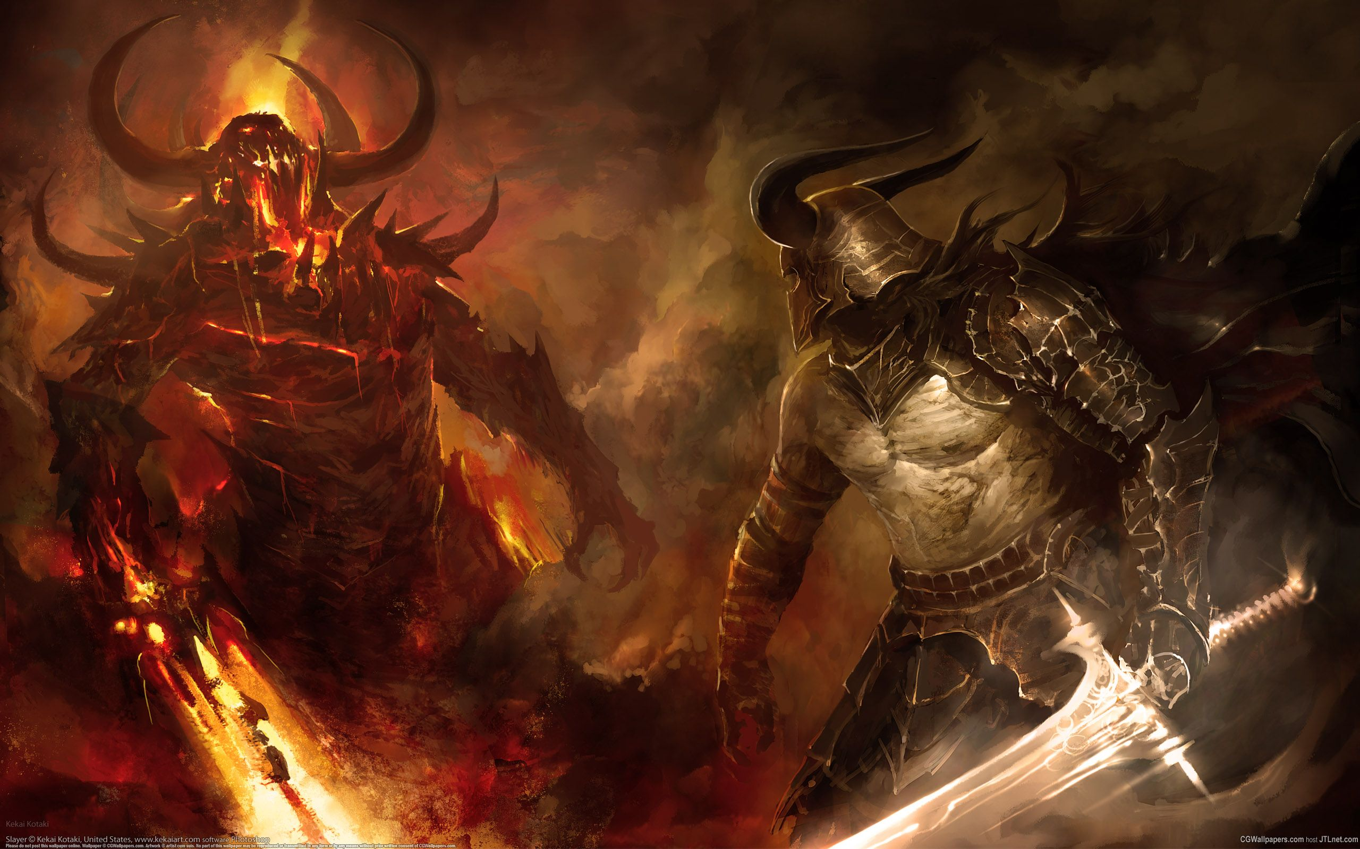
Fight hard now,

Slide 94
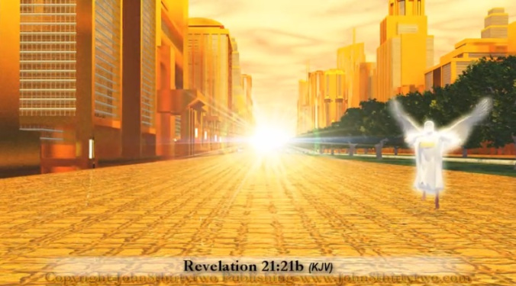
for we have peace in paradise for eternity!

Slide 95
We live in the “church age” known as the dispensation of grace.
We are called to LIVE for Christ.

Slide 96
After the rapture, will come the tribulation.
Believers then will have to DIE for Christ.

Slide 97
There are 2 types of people in the world today, what are they?
1.) Saved
2.) Unsaved
Don’t be fooled! Many who believe in Jesus will NOT go to heaven or be raptured.
Satan & his demons BELIEVE in Jesus, they know He exists & they are gong to Hell. To be saved you MUST follow Jesus!
Notes:
Don’t be fooled… -This is the scariest fact in the bible! Many who believe they will go to heaven will be sent to hell. They went to church, they were “good” people, some better than all of us, but they don’t have Jesus!
Before the next slide >
Picture this – It’s judgement day and you see a GREAT WHITE THRONE, and you walk up still believing that you are getting into heaven, then the books are opened & your name is missing in the Lamb’s Book of Life. Judgement is declared and you are sentenced to eternity in the lake of fire. As you are being pulled away by the angels you look to Jesus and plead your case… what will happen? Keep that in mind as we read Matt 7:21-23.

Slide 98
“Knowing the correct password—saying ‘Master, Master,’ for instance—isn’t going to get you anywhere with me. What is required is serious obedience—doing what my Father wills. I can see it now—at the Final Judgment thousands strutting up to me and saying, ‘Master, we preached the Message, we bashed the demons, our God-sponsored projects had everyone talking.’ And do you know what I am going to say? ‘You missed the boat. All you did was use me to make yourselves important. You don’t impress me one bit. You’re out of here.’
Matt 7:21-23 The Message bible

Slide 99
“Not everyone who calls out to me, ‘Lord! Lord!’ will enter the Kingdom of Heaven. Only those who actually do the will of my Father in heaven will enter. On judgment day many will say to me, ‘Lord! Lord! We prophesied in your name and cast out demons in your name and performed many miracles in your name.’ But I will reply, ‘I never knew you. Get away from me, you who break God’s laws.’
Matt 7:21-23 NLT
Notes:
“I never knew you, depart from me…”
Matt 7:23 - This is the scariest verse in the bible!

Slide 100
“Enter by the narrow gate; for wide is the gate and broad is the way that leads to destruction, and there are many who go in by it. Because narrow is the gate and difficult is the way which leads to life, and there are few who find it.
Matt 7:13-14

Slide 101
How many Jews left in the exodus?
Somewhere between 600,000-900,000.
Of those original Jews, how many entered the promised land?
2 Joshua & Caleb
0.000333…% of 600,000

Slide 102
How many people survived the flood?
8

Slide 103
What does that have to do with this group?
The deception of salvation may be Satan’s greatest tool in our country!
Notes:
We should be reaching out to people even in our churches when their actions & words don’t line up with what they profess, & not just the church but this group, EVERYWHERE!!!

Slide 104
What happens when we live prophesy?
We are told, in the last days, many will fall away from the faith.
Notes:
#2 – we are there, people are leaving the church in droves. Many well known “leaders” and they are taking many with them. How can this be?

Slide 105
The people leaving were believers, not followers of Jesus
When the people they followed left so did they.
Notes:
#2 make sure your not following your pastor, friend, mom, dad, husband, wife, son, mom, dad – anyone. Because if that person leaves, dies whatever you will fall away too.

Slide 106
Many of us are not giving Jesus ALL of us. We are giving some of us.
We can turn around RIGHT NOW!!!
Notes:
We are leaving others to die Ezk 33 – Watchmen.

Slide 107
THE CALL OF THE
HOLY SPIRIT
Notes:
If there is anyone here who isn’t 100% sure they are a FOLLOWER & not just a believer in Jesus, this is a call to Salvation!
I will pray. With all heads bowed and all eyes closed ask for hands for any who want saved then those who want to reaffirm their commitment to Jesus.
Next slide.

Slide 108
PRAYER

Slide 109
Comments & Feedback

